Slide 1
Introduction to IQmol: Part II
Fazle Rob, Shirin Faraji, Ilya Kaliman, and Anna Krylov

Slide 2
Resources
Written by Dr. Andrew Gilbert
Keep yourself up to date with IQmol website: http://iqmol.org
IQmol Youtube channel: IQmol now has its own Youtube channel

Slide 3
Performing Q-Chem calculations
Advanced examples

Slide 4
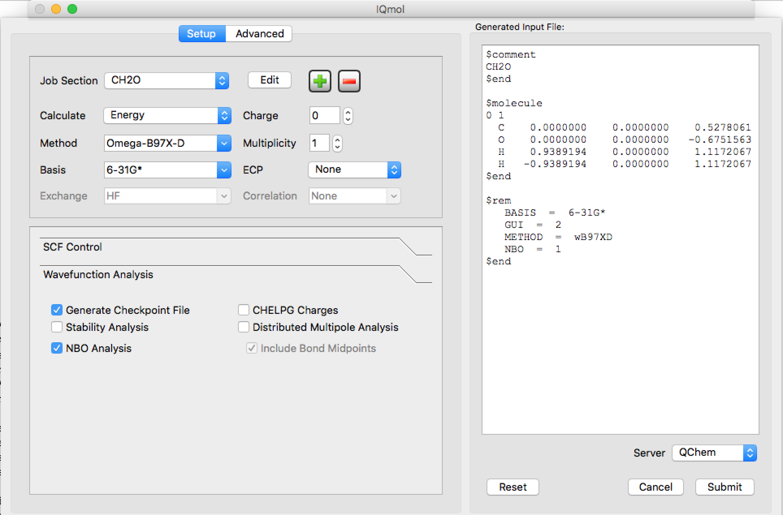
Advanced: NBO analysis
Take the optimized geometry (final coordinate after geometry optimization) and copy in the preview of input file
NBO = 1

Slide 5
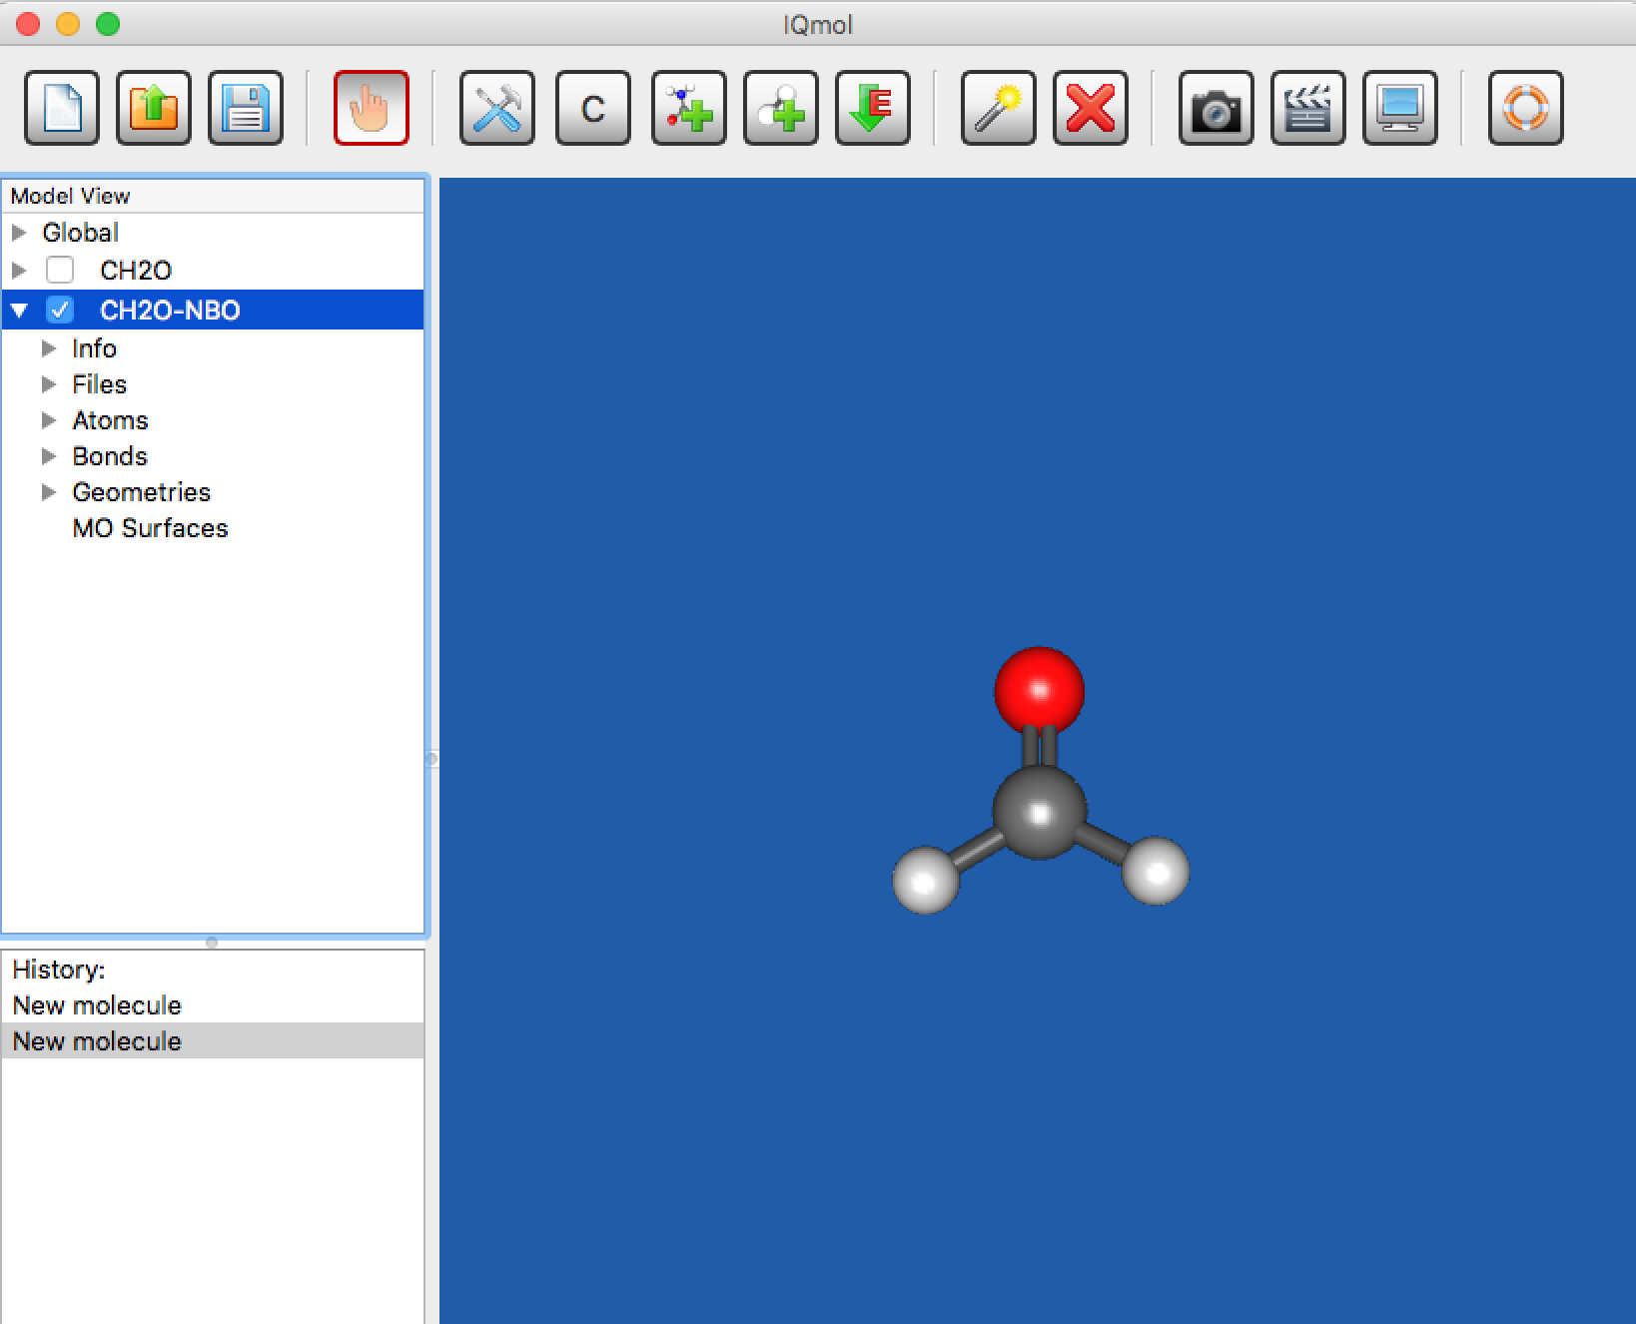
NBO analysis
Submit the job
Copy back the output into your laptop
Click the checkbox

Slide 6
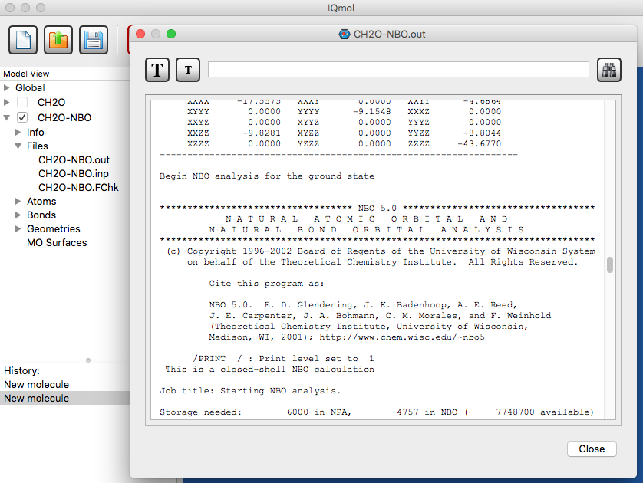
NBO analysis
Click on Files
Open CH2O-NBO.out file
Output from NBO calculations

Slide 7
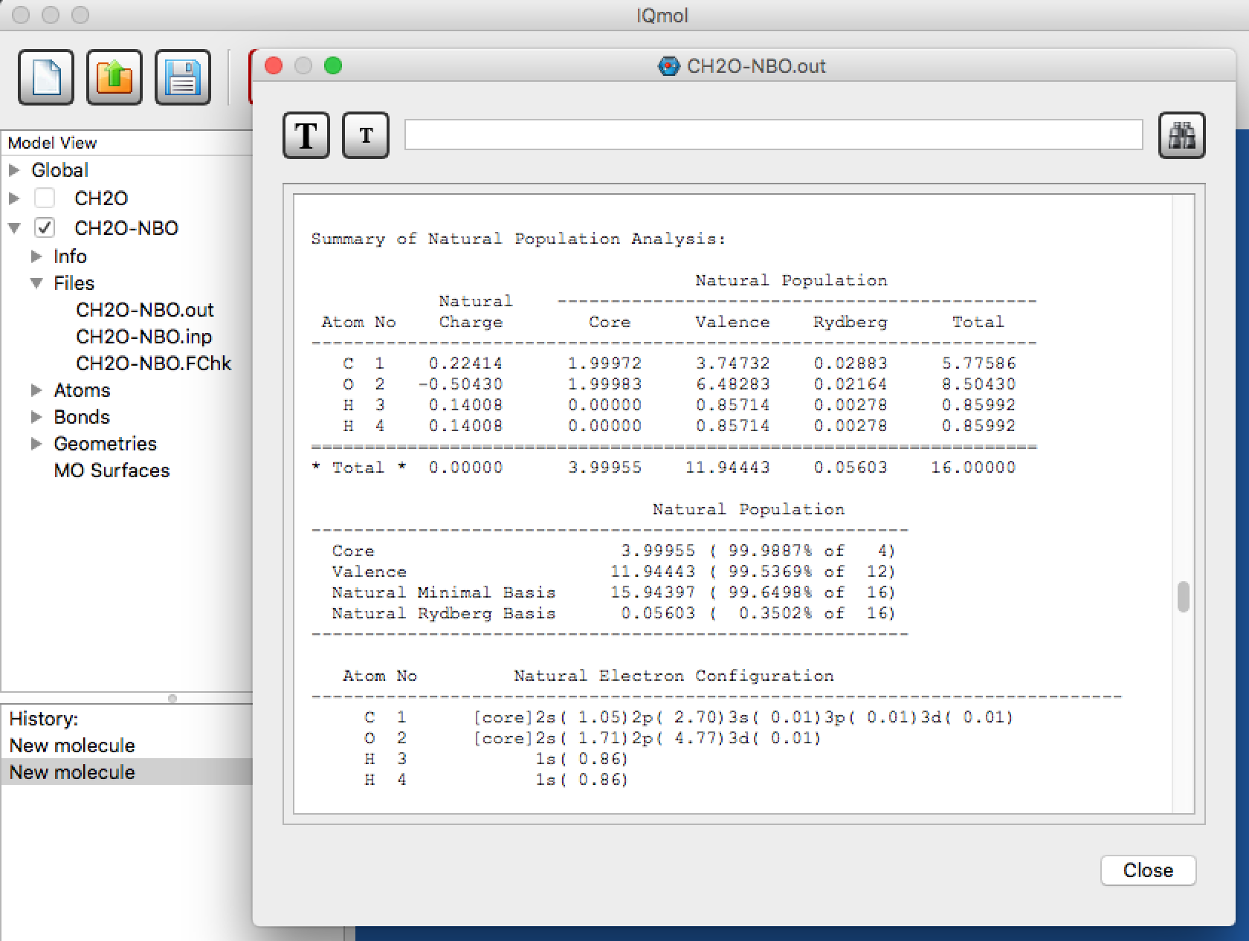
NBO analysis
Atomic charges
Atomic orbital populations

