Slide 1
Introduction to IQmol:
Part I
Fazle Rob, Shirin Faraji, Ilya Kaliman, and Anna Krylov

Slide 2
IQmol: Resources
Written by Dr. Andrew Gilbert
Keep yourself up to date with IQmol website: http://iqmol.org
IQmol Youtube channel: IQmol now has its own Youtube channel

Slide 3
IQmol: Building molecules
Open IQmol, the molecule building screen looks like this:
Iqmol 2.7.1 is used for this presentation

Slide 4
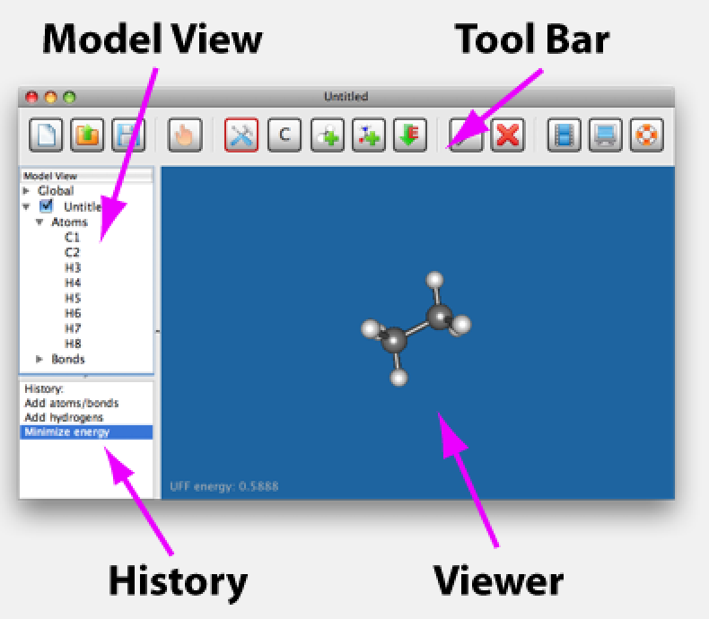
Iqmol: Quick overview
(MV)

Slide 5
IQmol: Main build tools
Build Mode
Add Hydrogens
Minimize Energy (classical forcefield)
Build Elements
(periodic table)
Add Fragments
(pre-built molecules)

Slide 6
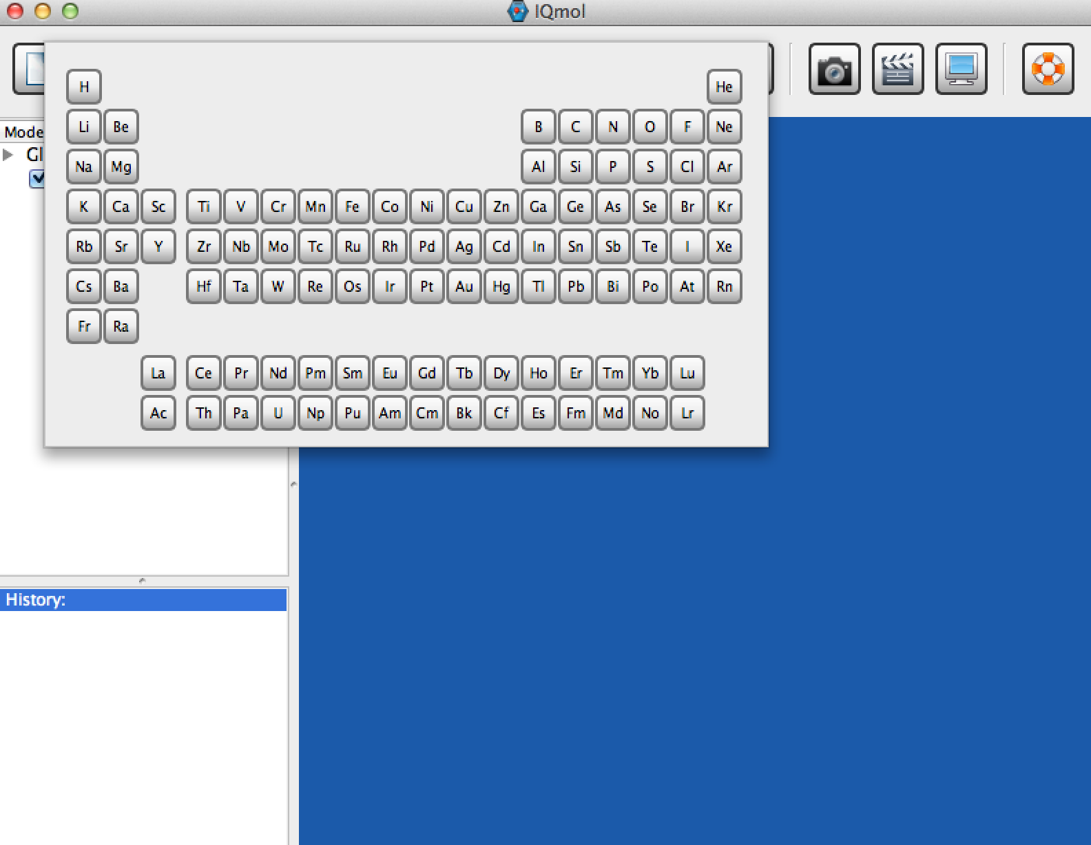
IQmol: Building molecules
Click the “Build Element” : periodic table pops up:

Slide 7
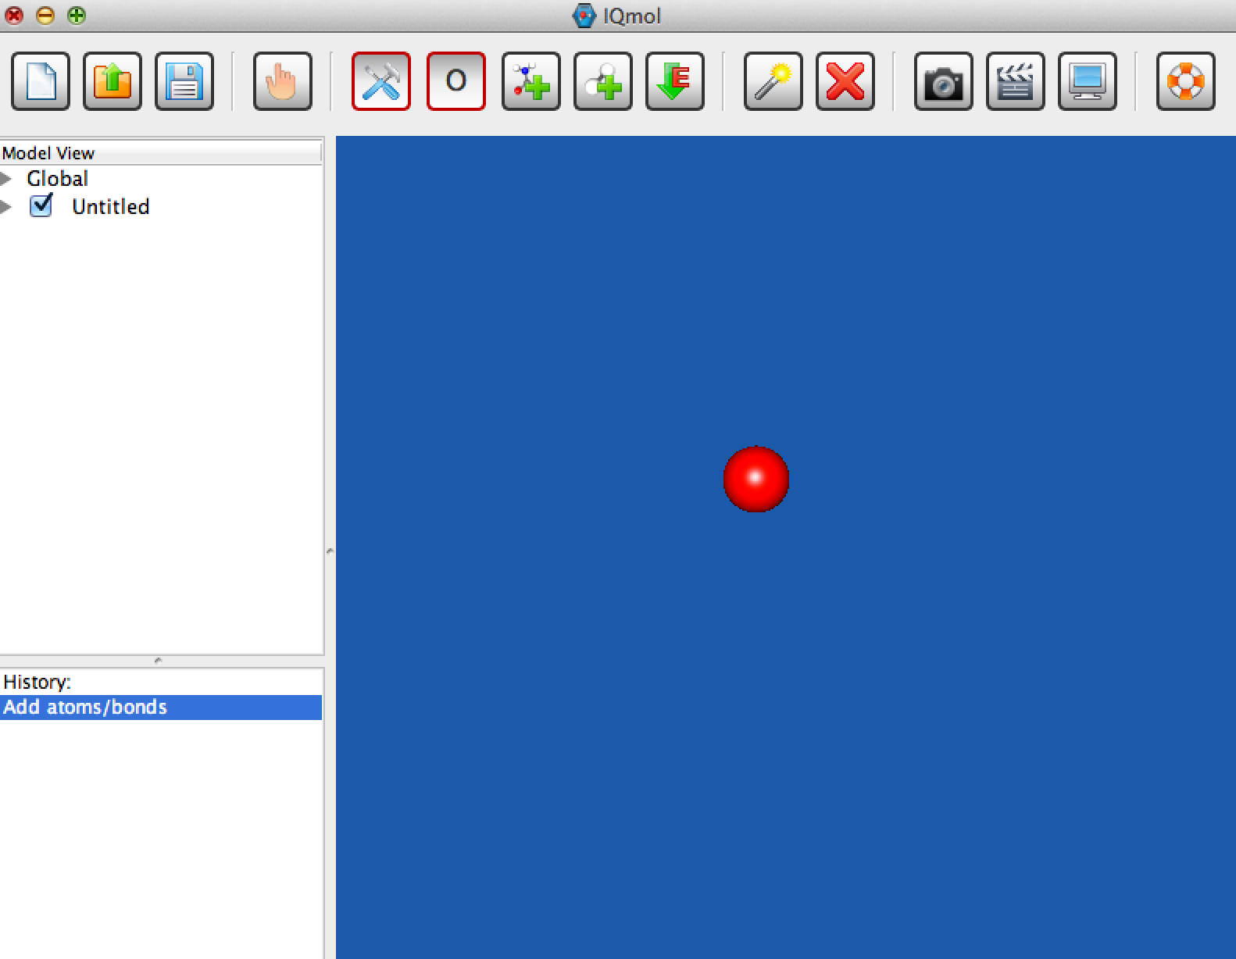
IQmol: Selecting atom
Select an atom, for example Oxygen: O
Click in the blue screen (Viewer) area to place the Oxygen atom

Slide 8
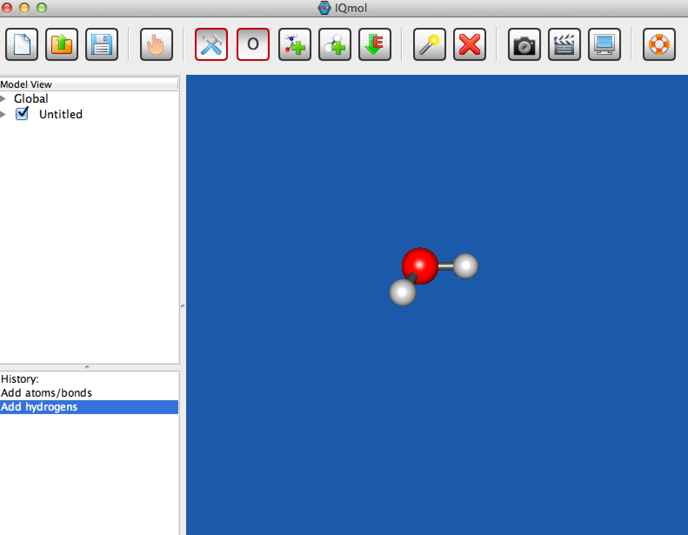
IQmol: Add Hydrogen
Click the “Add Hydrogens” button:

Slide 9
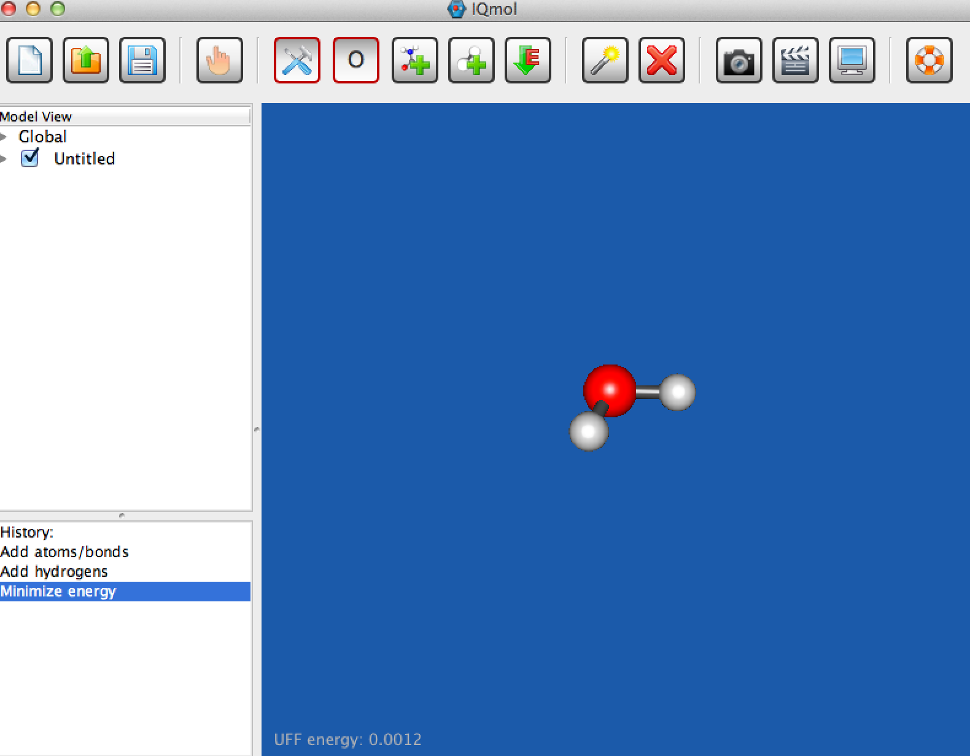
IQmol: Classical minimizer
Click the “Minimize Energy” button to get a more realistic structure
Energy of the current structure

Slide 10
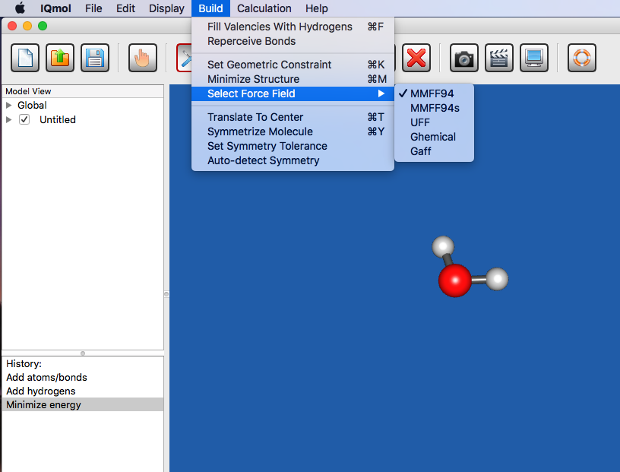
IQmol: Classical minimizer
Build —> Select Force Field: allows you to choose different force field

Slide 11
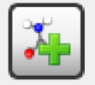
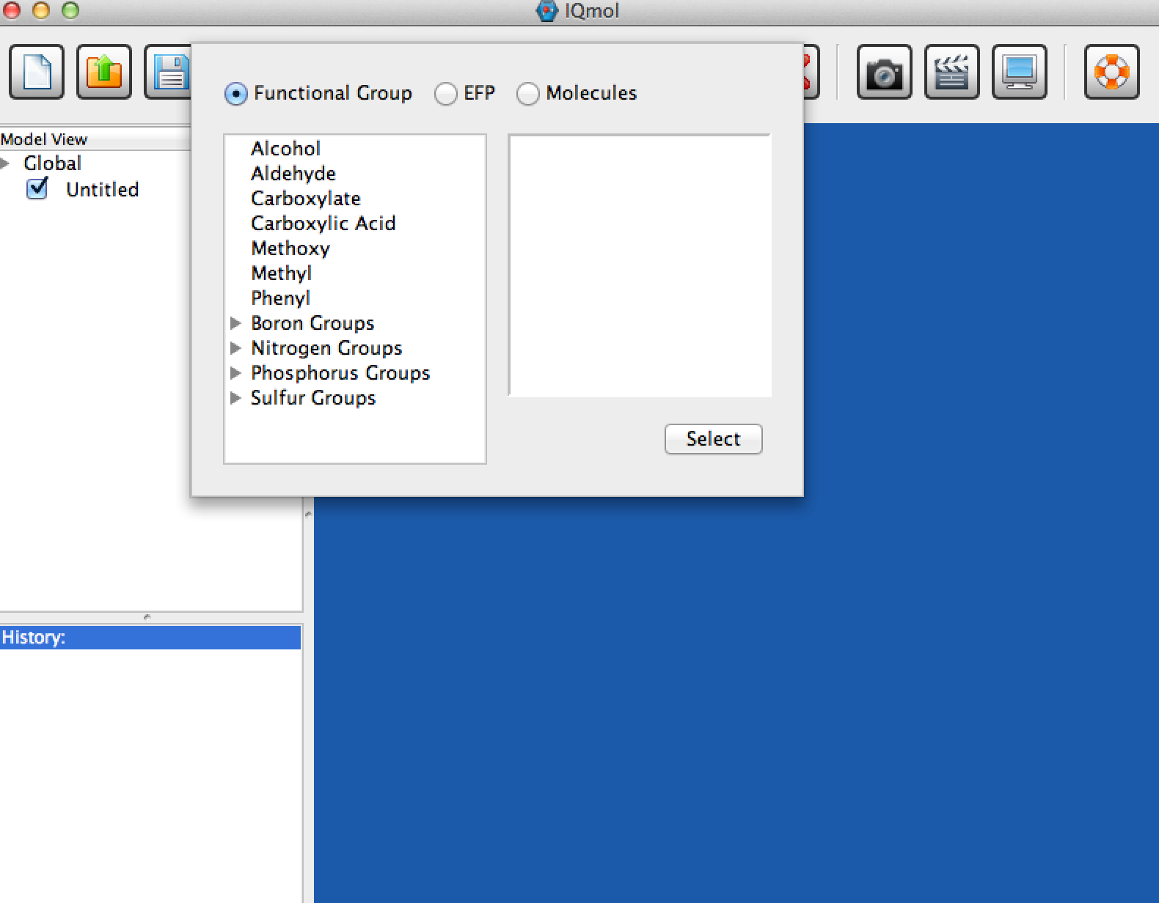
IQmol: Pre-build molecules
Pre-build molecule library (“Add Fragments” button ) contains various
molecules that can be used to build more complex molecules

Slide 12
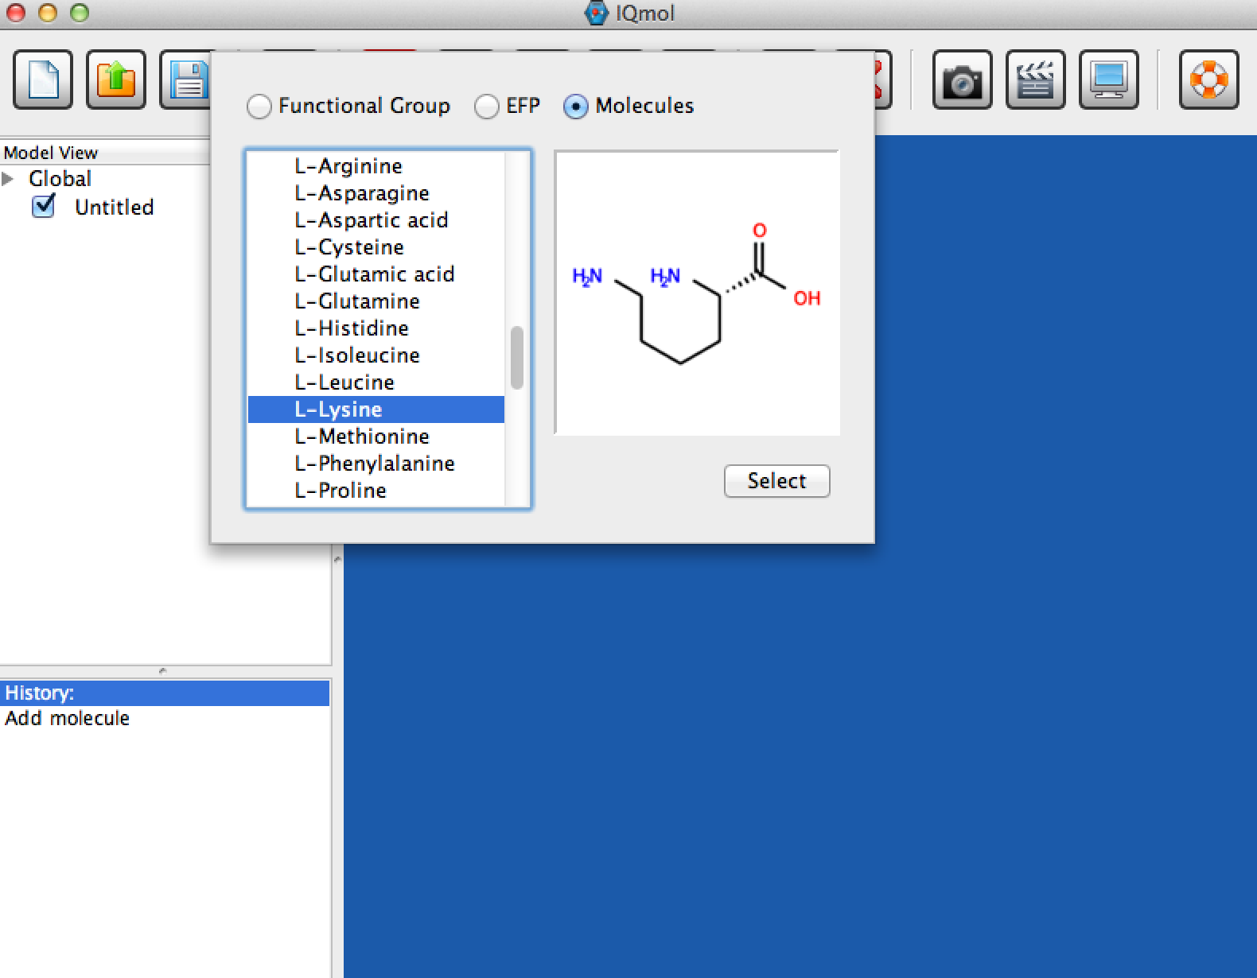
IQmol: Pre-build molecules
Click on the “Add Fragment” button , then choose amino_acids/L-lysine.

Slide 13
IQmol: Manipulation Mode
Click on the “Manipulate” mode
Replace CTRL with command key for Mac

Slide 14
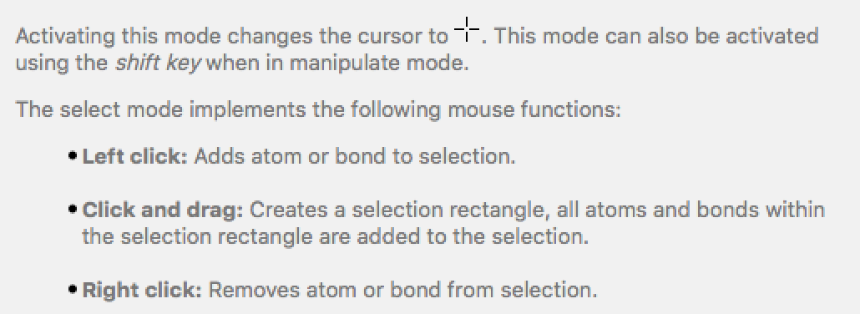
IQmol: Select Mode
Click on the “Select” mode
Press “CTRL” and the left/right mouse (two fingers on Mac Trackpad) button to move the group of selected atoms [Replace CTRL with command key for Mac. For Mac Tracpad do the corresponding finger gesture]

Slide 15
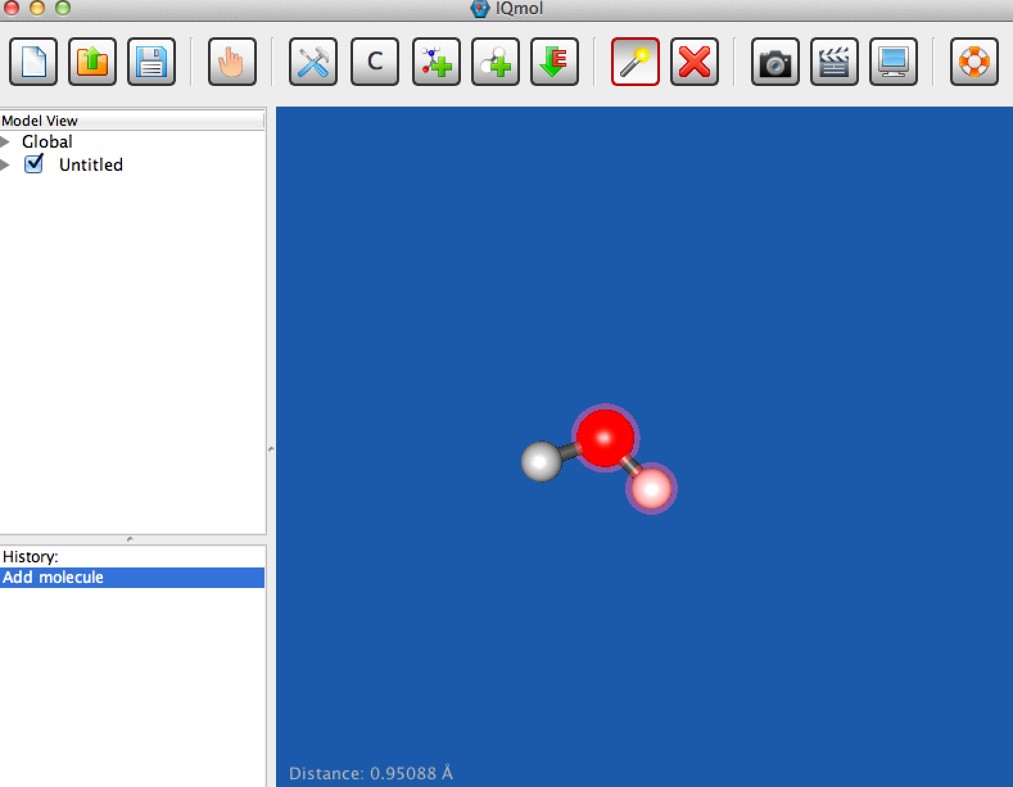
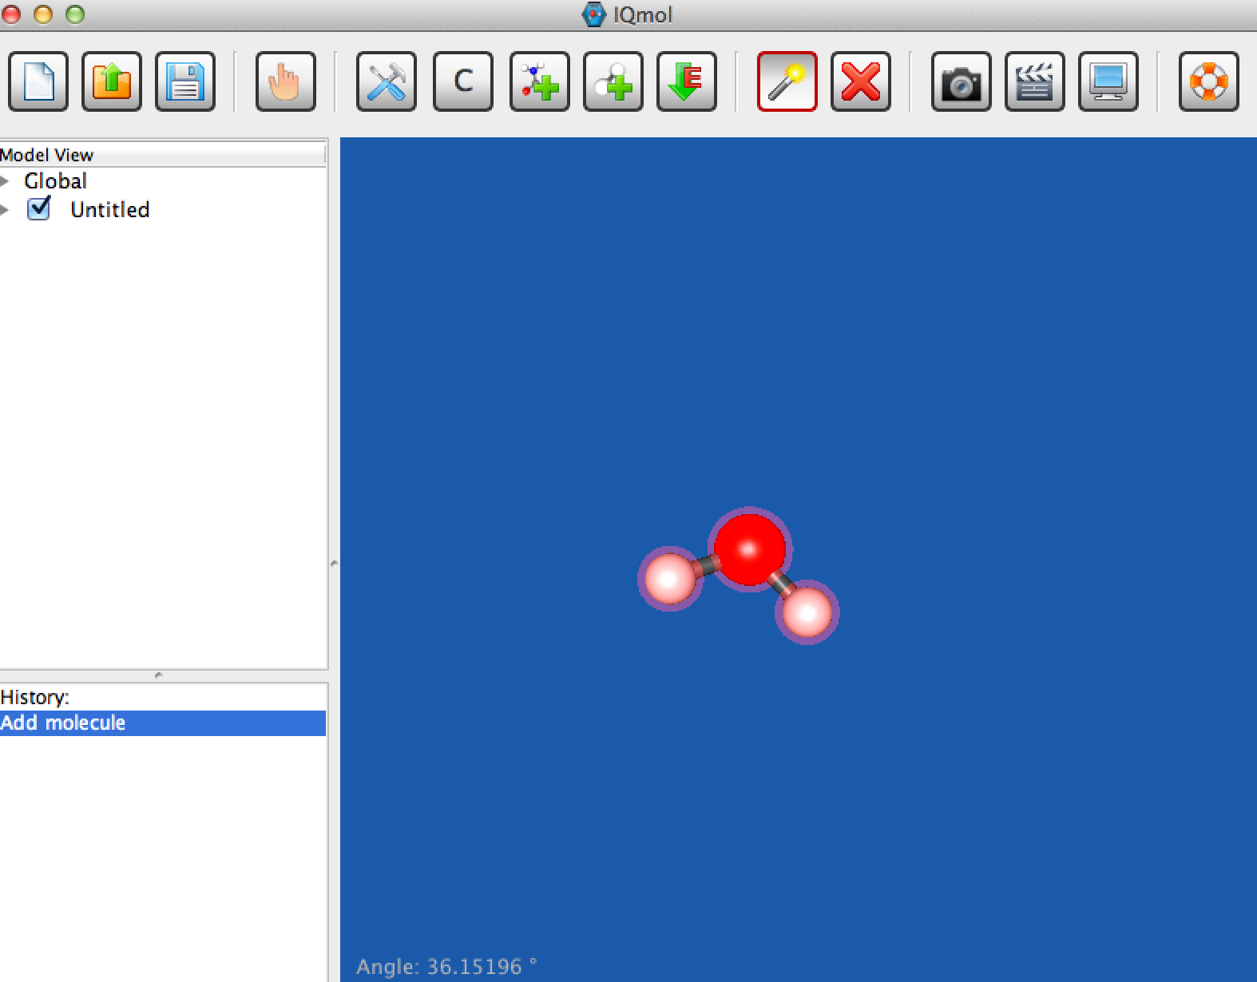
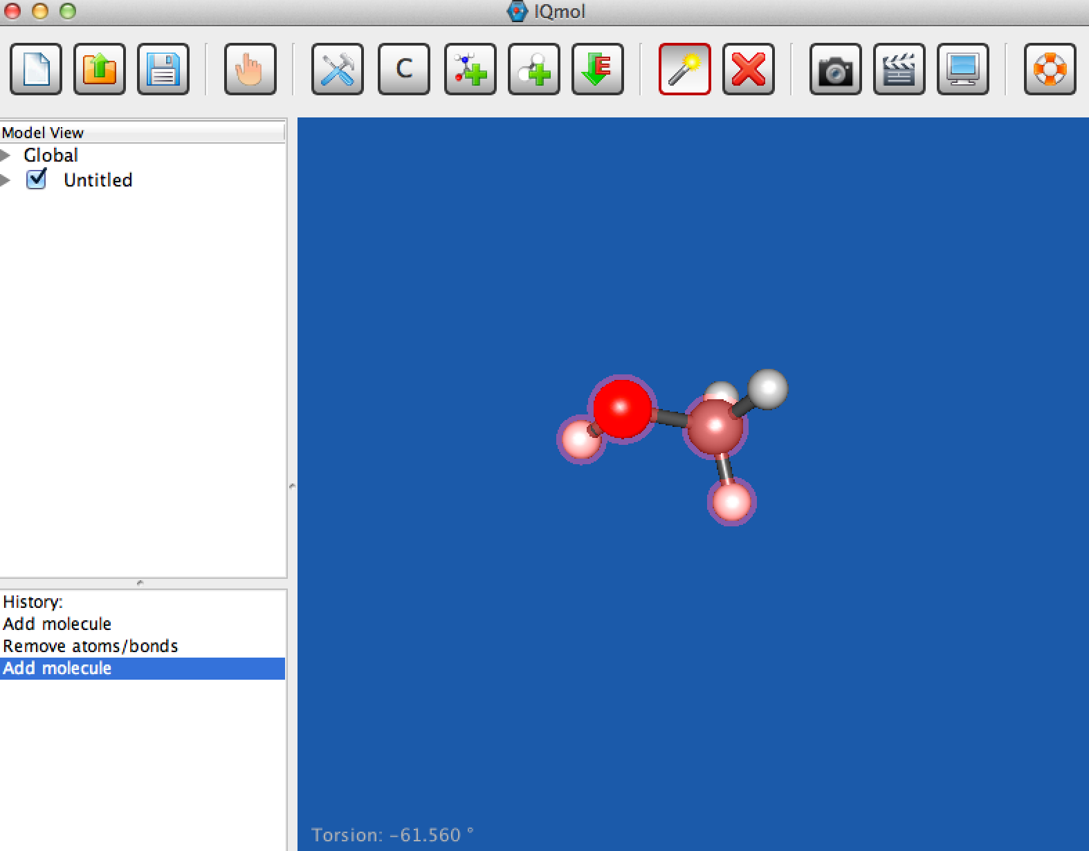
IQmol: Measuring bond length, angles, and dihedrals
Click the select button
Select 2, 3 or 4 atoms as necessary
the measured bond length or angle or dihedral is displayed in the bottom corner:
The bond length is displayed here

Slide 16
Performing Q-Chem calculations
Example 1: H2O
Prerequisite: Consult IQmol-Server-Setup tutorial

Slide 17
H2O
Build molecule, clean-up (force-field opt-n), check symmetry (symmetrize molecule)
Optimize B3LYP/6-31G*
Play with changing the view of the molecule, move it around, zoom
Use ‘Select’ feature to measure bonds and angles
Look at MOs: HOMO, HOMO-1; LUMO
Run FREQ job, look at vibrations (click versus double-click)

Slide 18
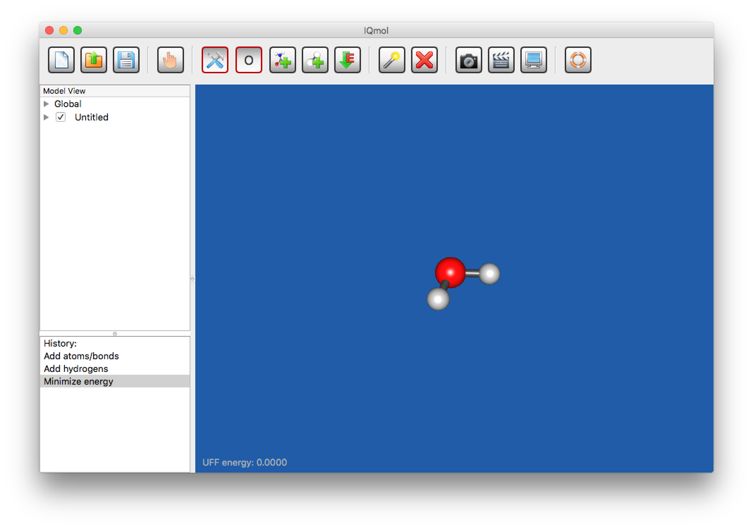
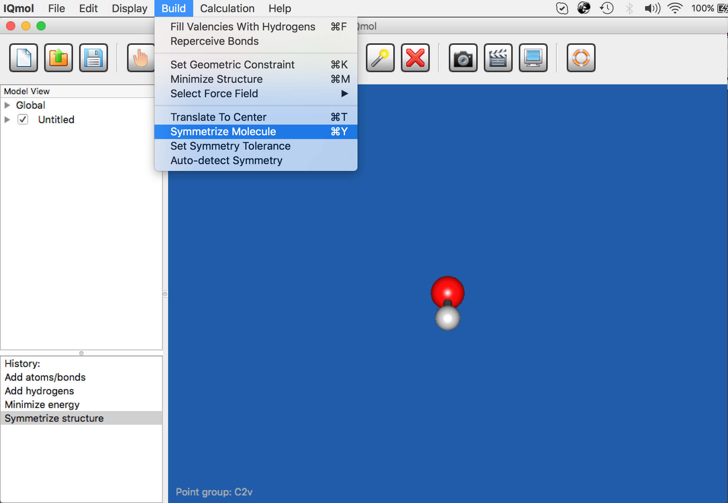
Building up/Check symmetry

Slide 19
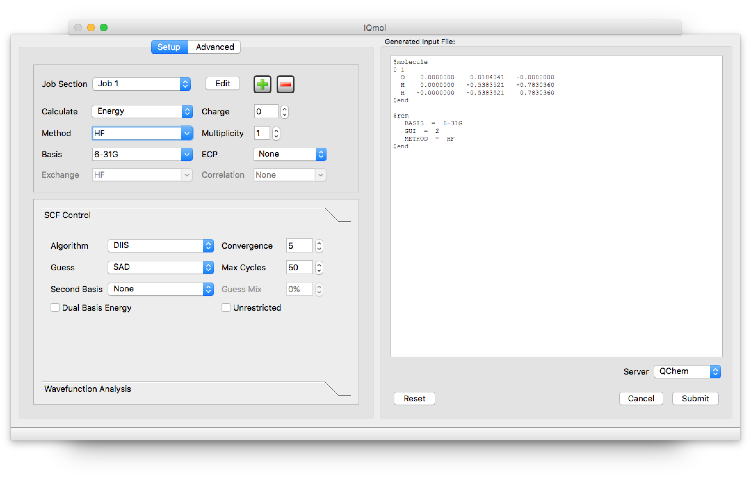
Performing Q-Chem Calculations
From menu bar:
Calculation Q-chem Setup; open Q-chem User Interface (QUI) input editor

Slide 20
QUI
QUI has 2 windows
Details of the calculation
Preview of the input file

Slide 21
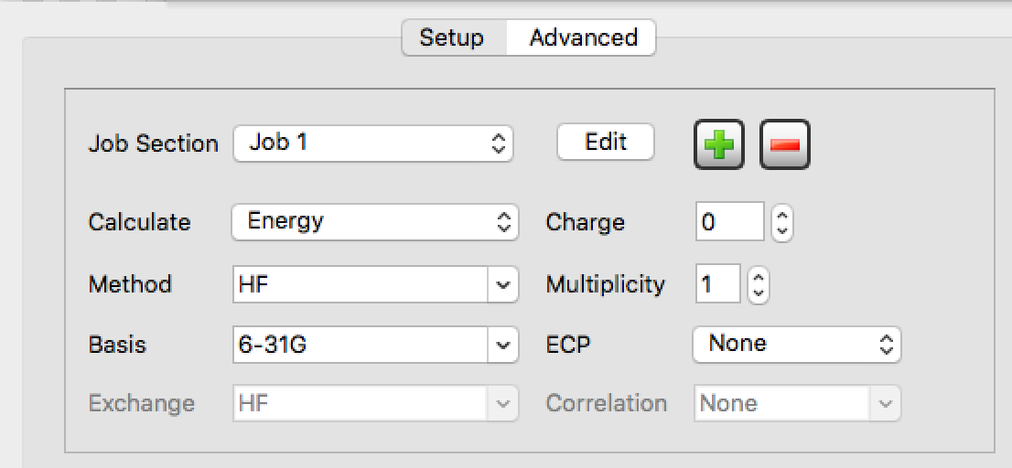
QUI
There are 2 windows in “Computational details” section
Advanced calculations
Basic setup

Slide 22
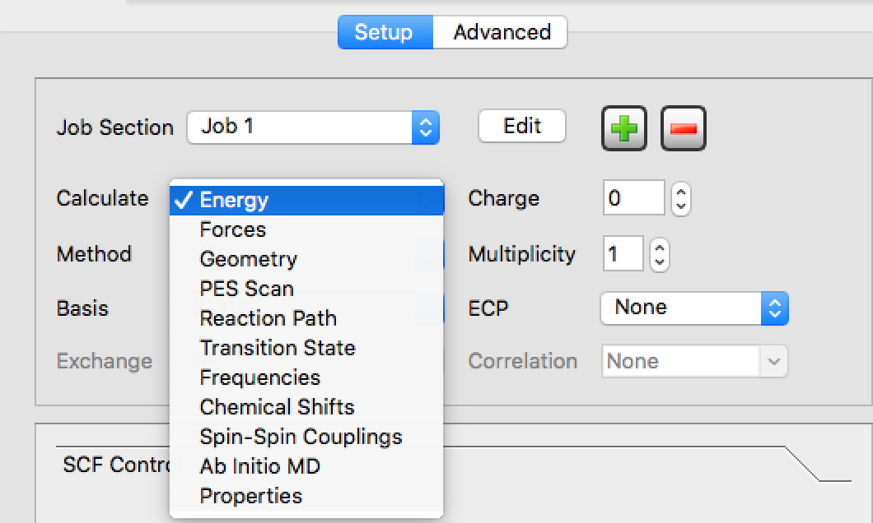
Setting up the job type, method, basis set

Slide 23
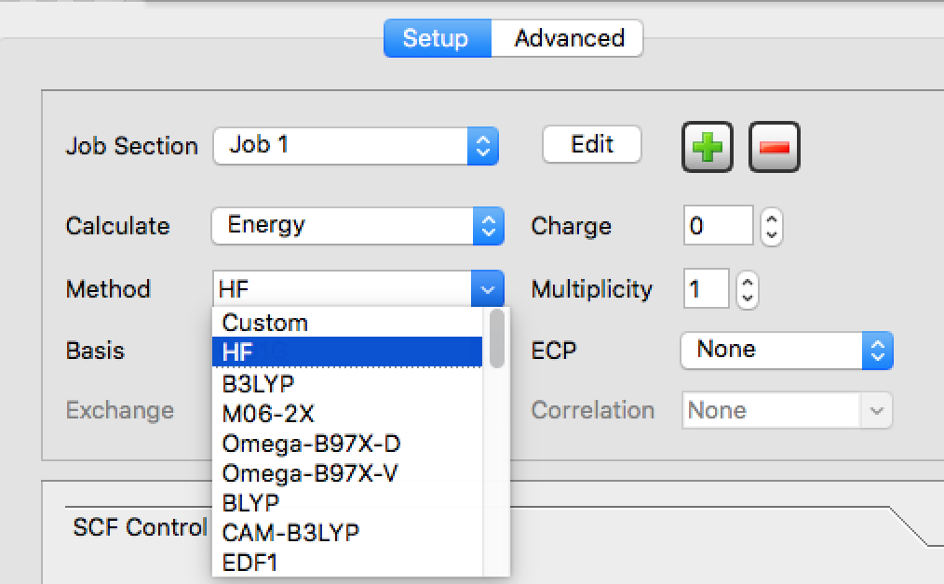
Setting up the job type, method, basis set

Slide 24
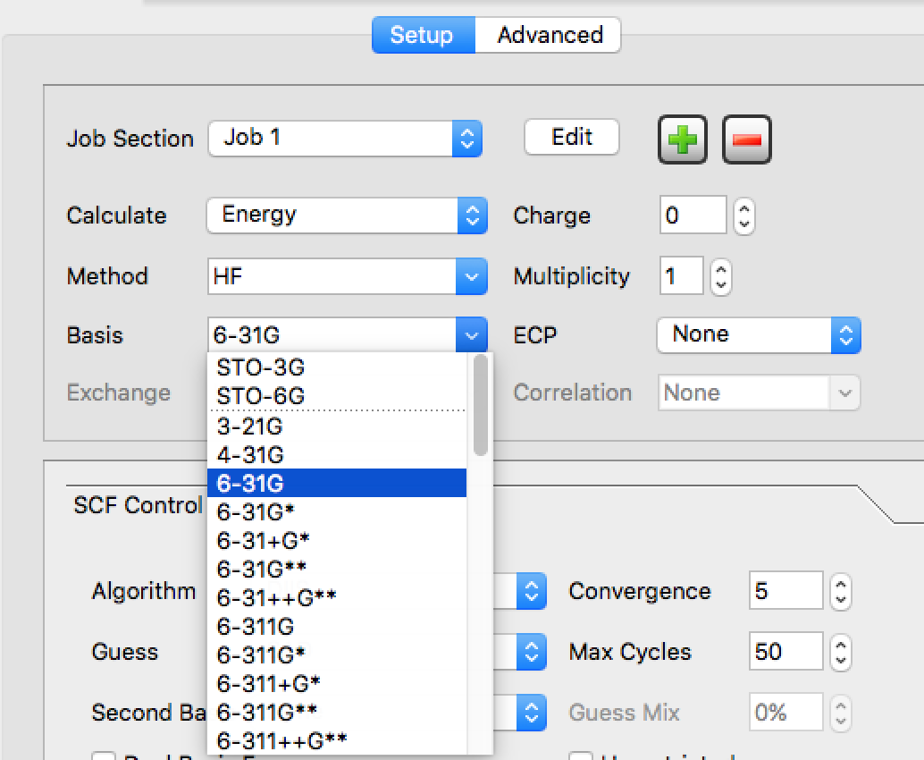
Setting up the job type, method, basis set

Slide 25
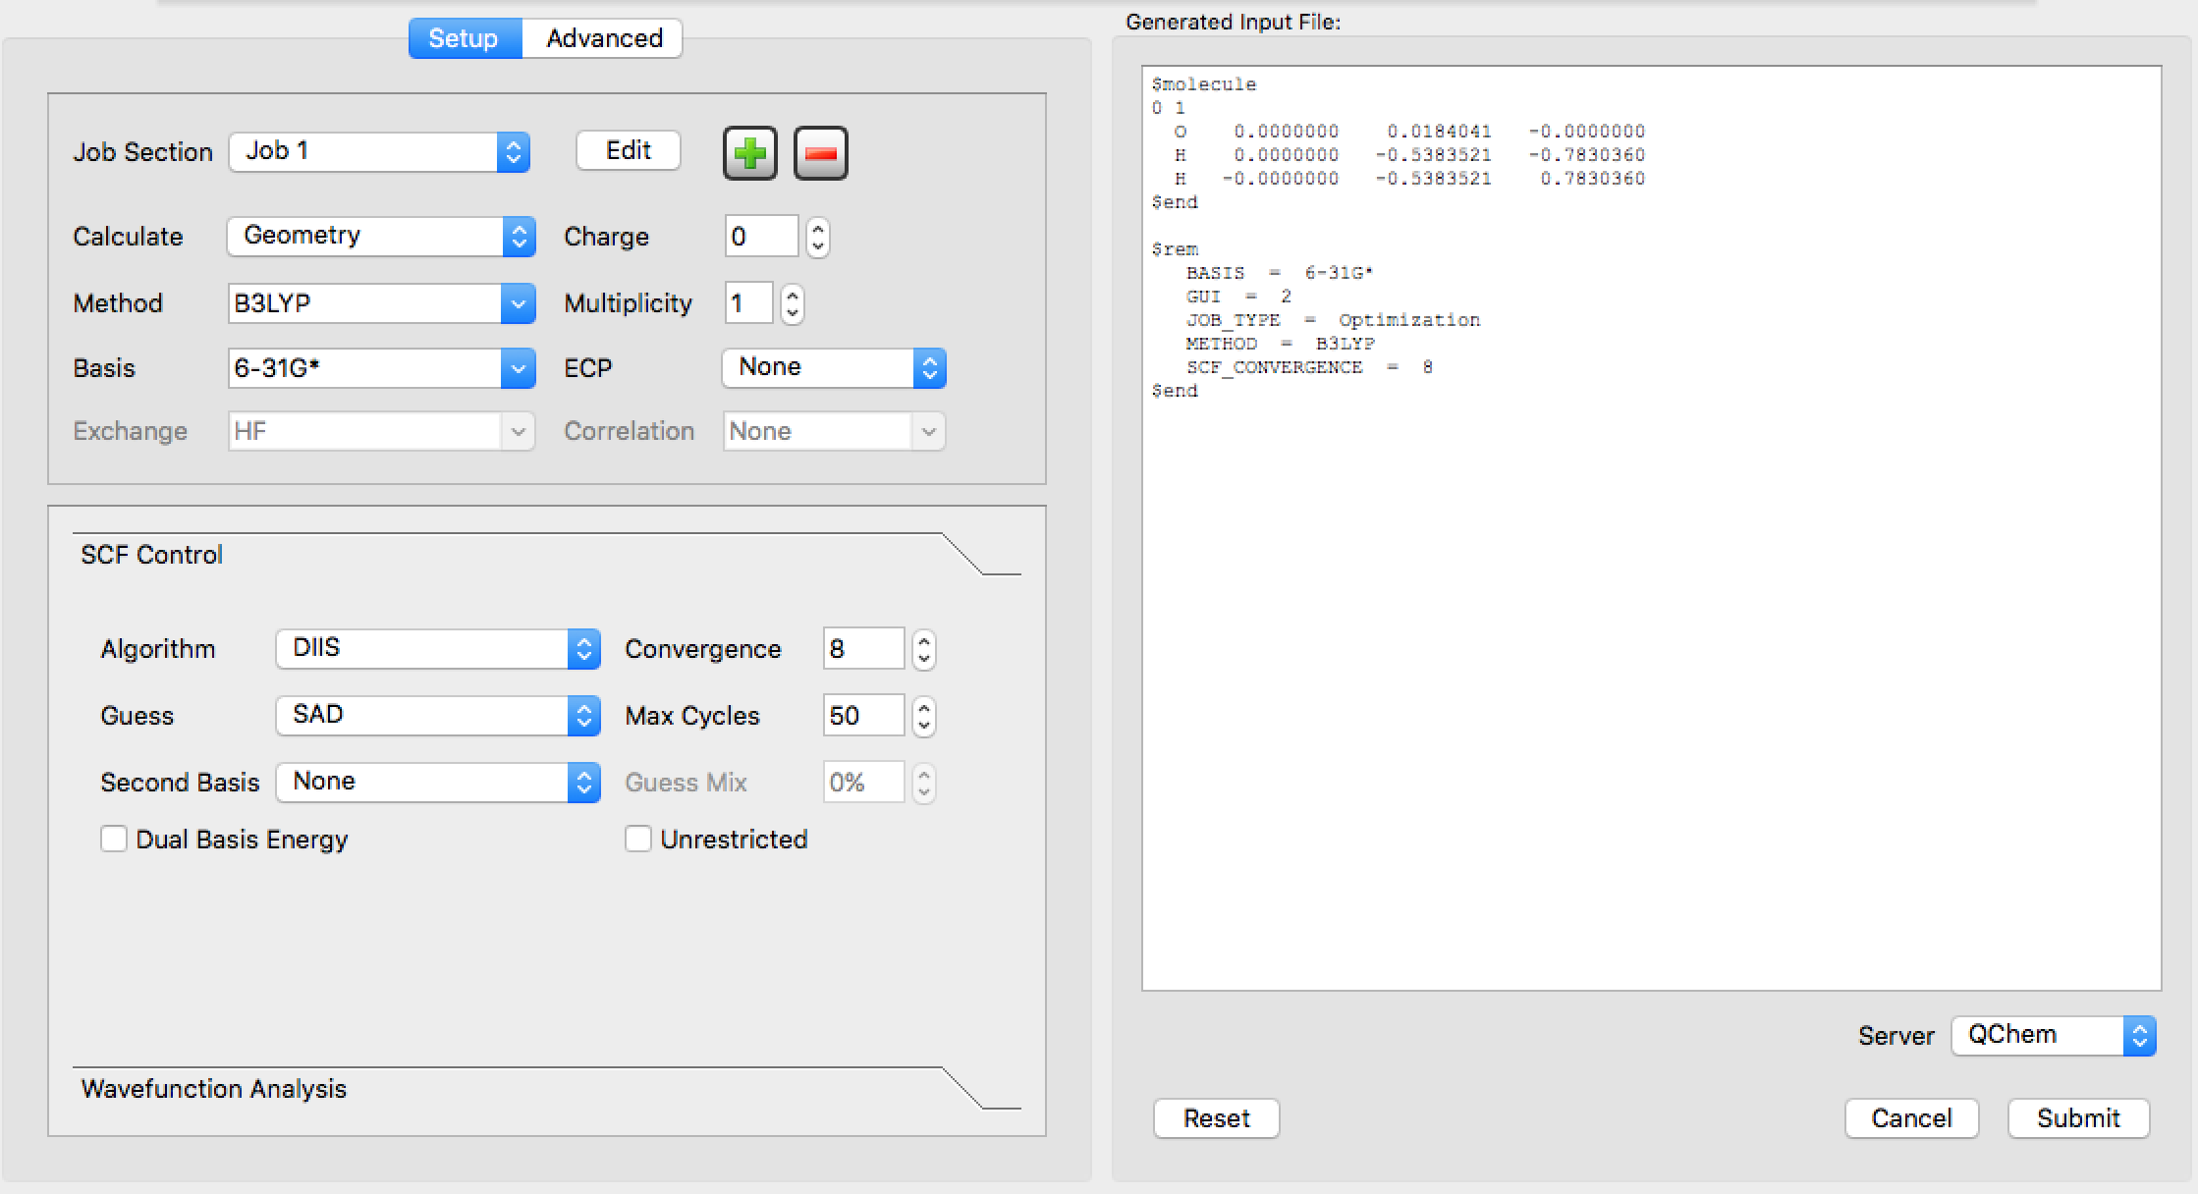
H2O: Optimization and Frequency
Take H2O molecule and perform “Optimization” and “Frequency” analysis
First optimization:

Slide 26
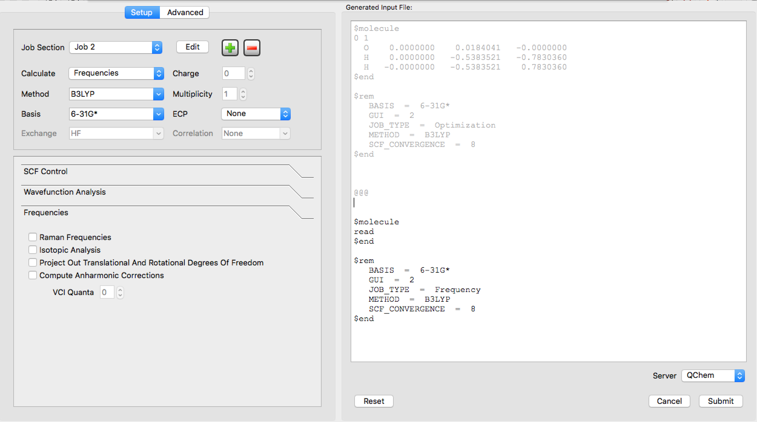
H2O: Optimization and Frequency
Use add button to submit multiple jobs within one input file: such as optimization and frequency to be performed subsequently
New job starts
Read the geometry from the previous calculation

Slide 27
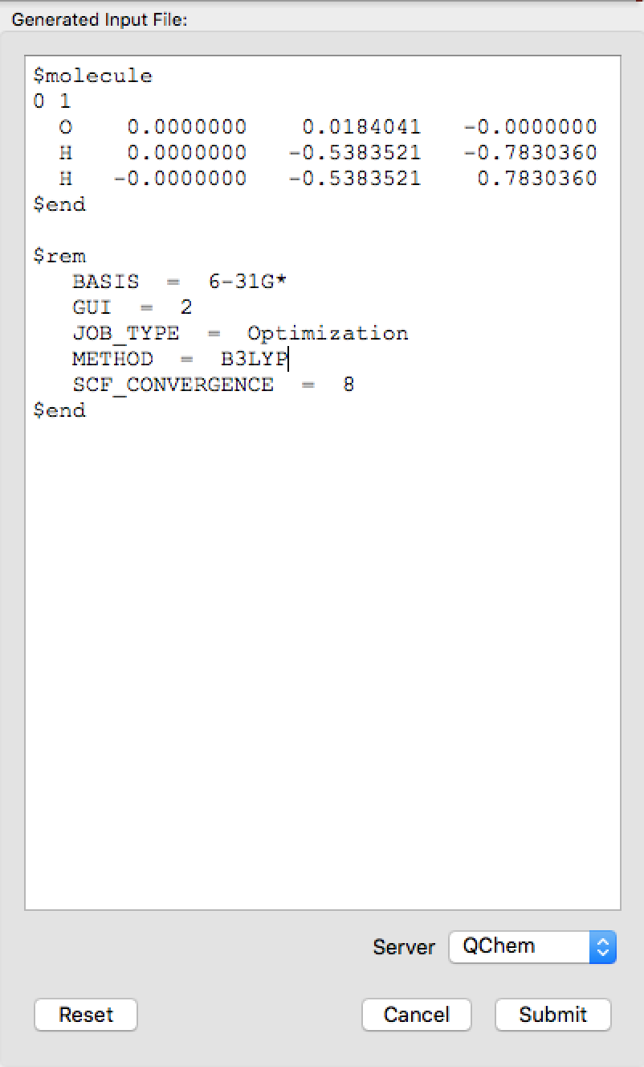
Input editing
One can manually modify the input preview
$rem section

Slide 28
Saving input file
Save the input on a disk: File save as
Use .inp for name of the input file

Slide 29
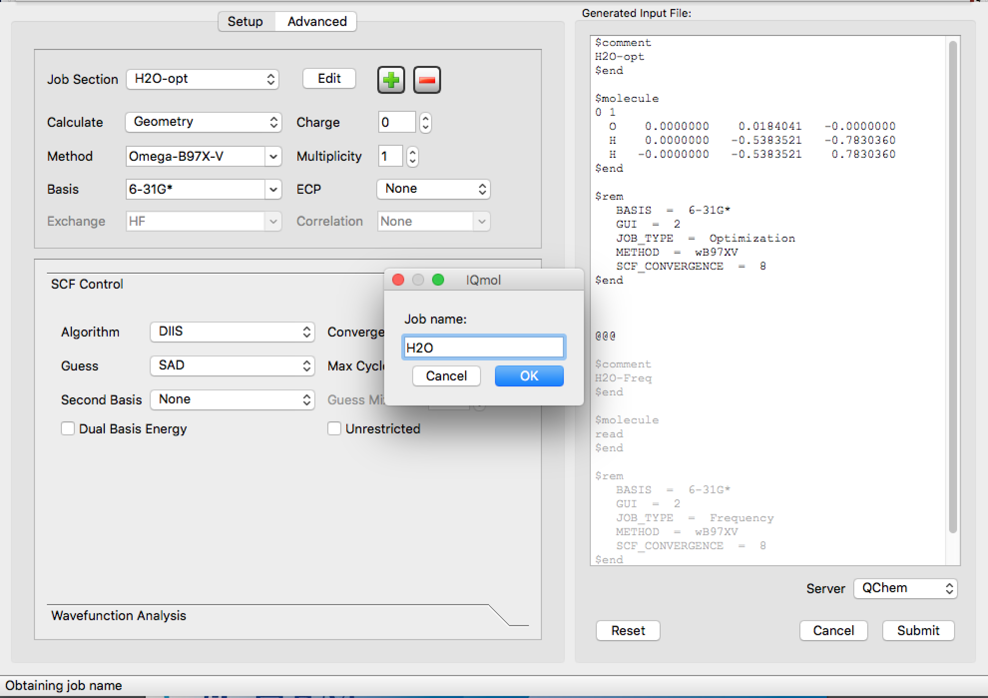
Submitting job to Iqmol server iqmol.q-chem.com
Give a name and remember it.

Slide 30
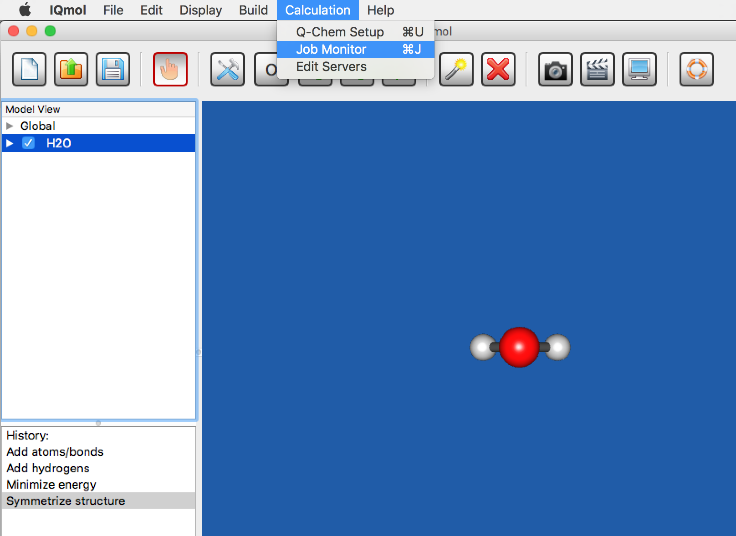
Job Status
Check the job status by selecting: “Calculation —>Job Monitor”

Slide 31
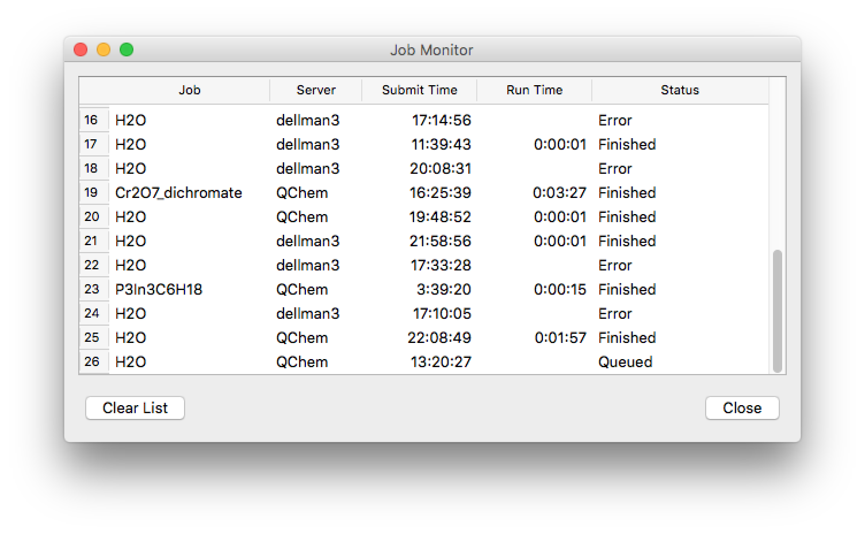
Monitoring submitted job
Check the job status by selecting: “Calculation —>Job Monitor”

Slide 32
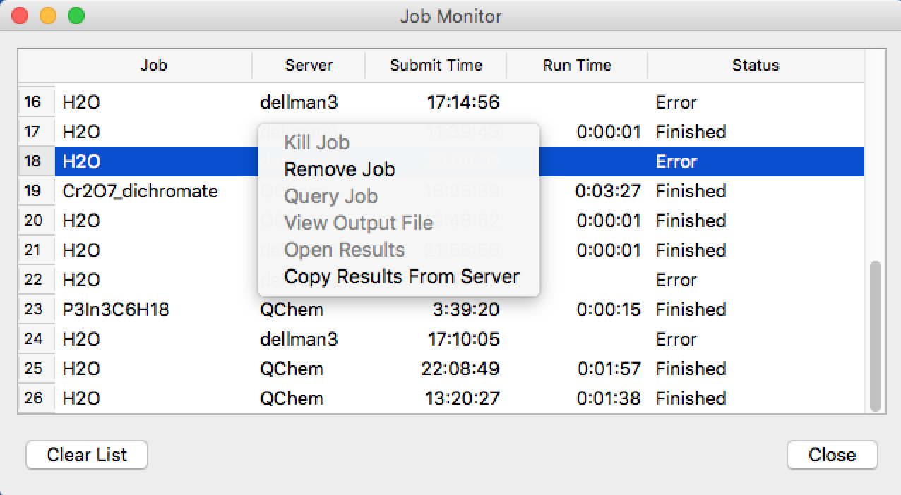
Monitoring submitted job
use left mouse button to select the job
Job status:
kill the job by selecting this option
use right mouse button to see this menu

Slide 33
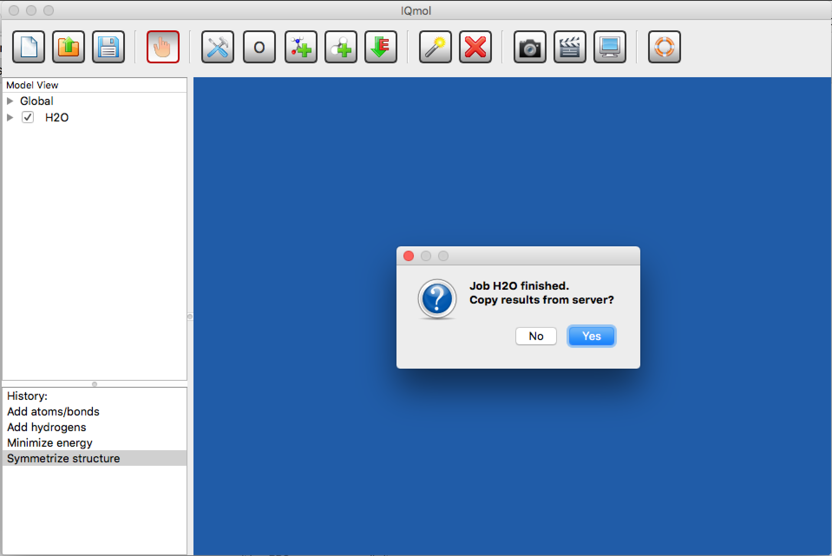
Job is finished

Slide 34
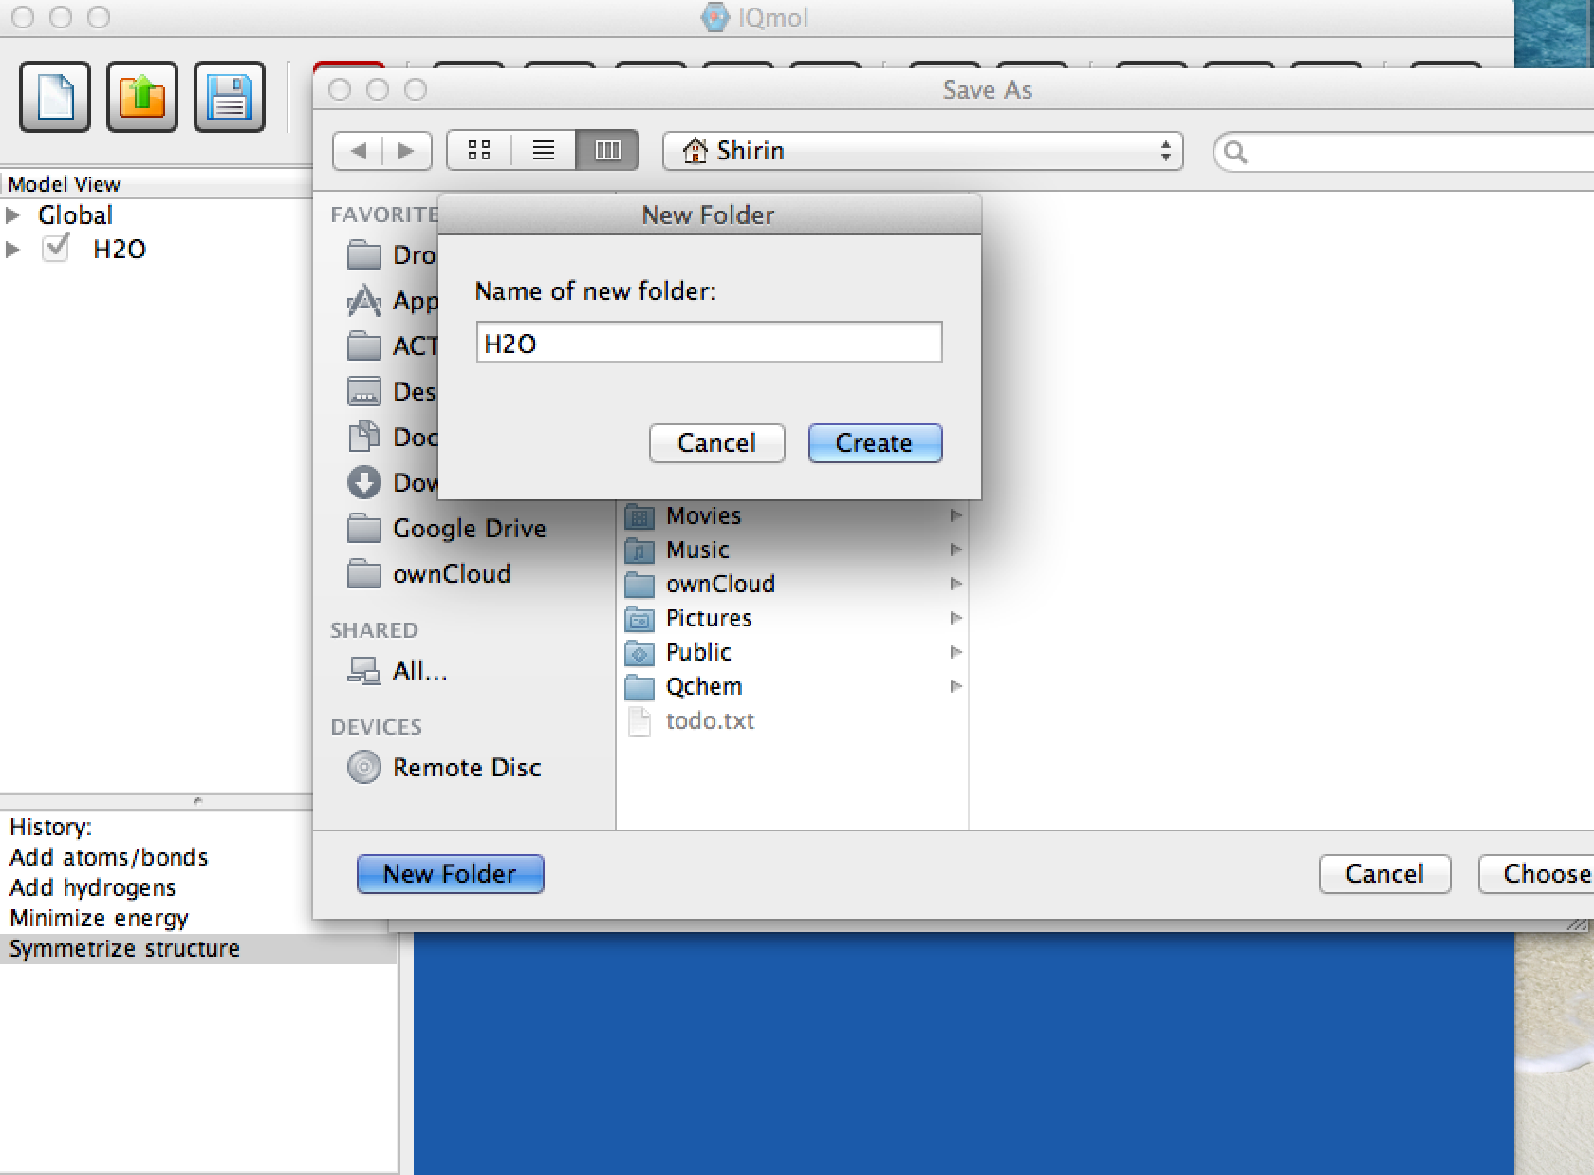
Copy files to your laptop
Create new folder to store output files:

Slide 35
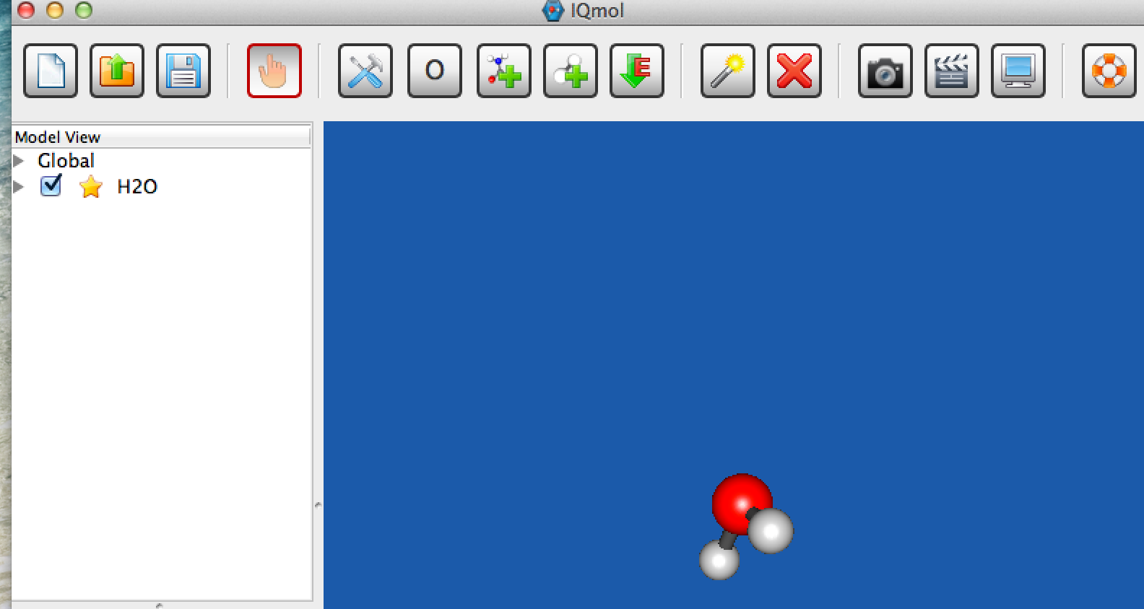
After you copied files to your laptop
Golden star shows that it is copied properly.
Click the checkbox !

Slide 36
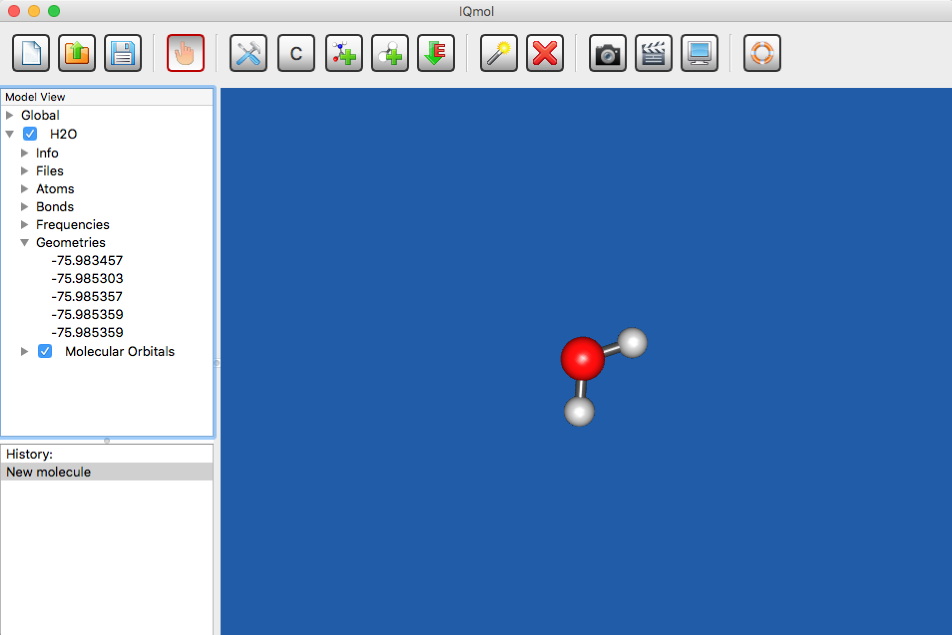
Analyzing Output: Optimization
After the calculations has been completed, open the .out (output) with IQmol. The example here is H2O after optimization and frequency analysis.
Click the small arrow next to the checkbox to see various calculated properties
Clicking the arrow next to Geometries gives the calculated energy at every step of optimization

Slide 37
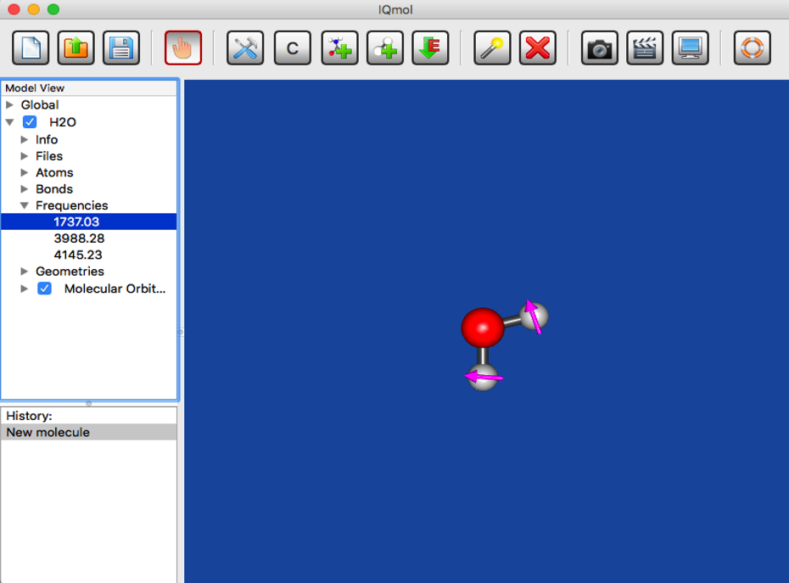
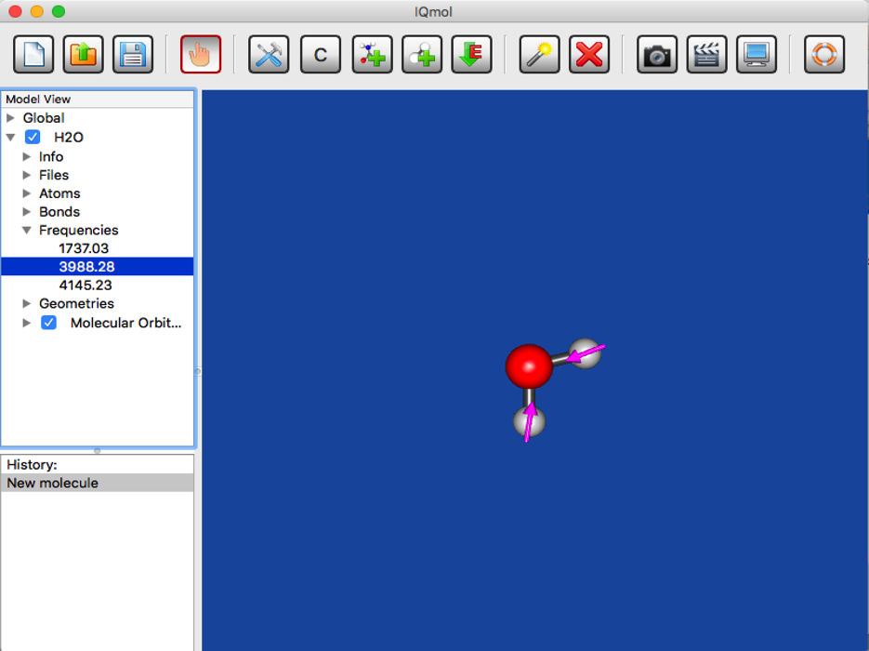
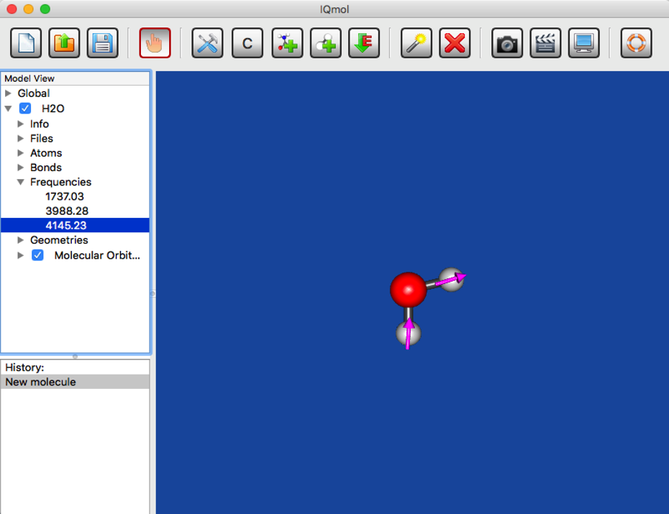
Analyzing Output: Frequencies
Clicking the arrow next to Frequencies gives the calculated frequencies and displaced vectors for each frequency (for H2O: 3N-6=3 vibrational frequencies)
Double click at each value to animate the vibration

Slide 38
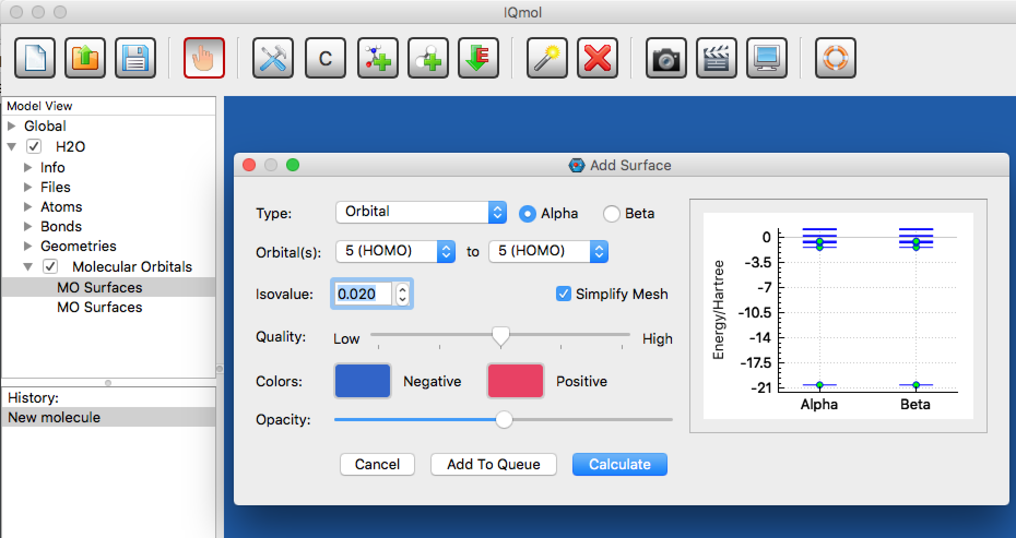
Analyzing Output: Orbitals, Density, Spin Density ,…
Must add GUI = 2 in the $ rem section (IQmol does it by default)
Open .Fchk file to see orbitals, density, spin density and so on.
Double click on MO Surfaces under Molecular Orbitals (mac) and a window pops up

Slide 39
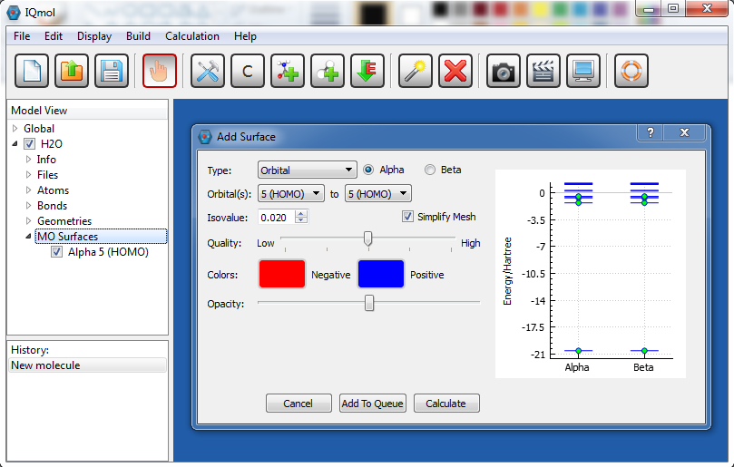
Analyzing Output: Orbitals, Density, Spin Density ,…
For MS Windows views are little different
Just double click on MO Surfaces and “Add Surface” window pops up
Screen shot from Windows 7

Slide 40
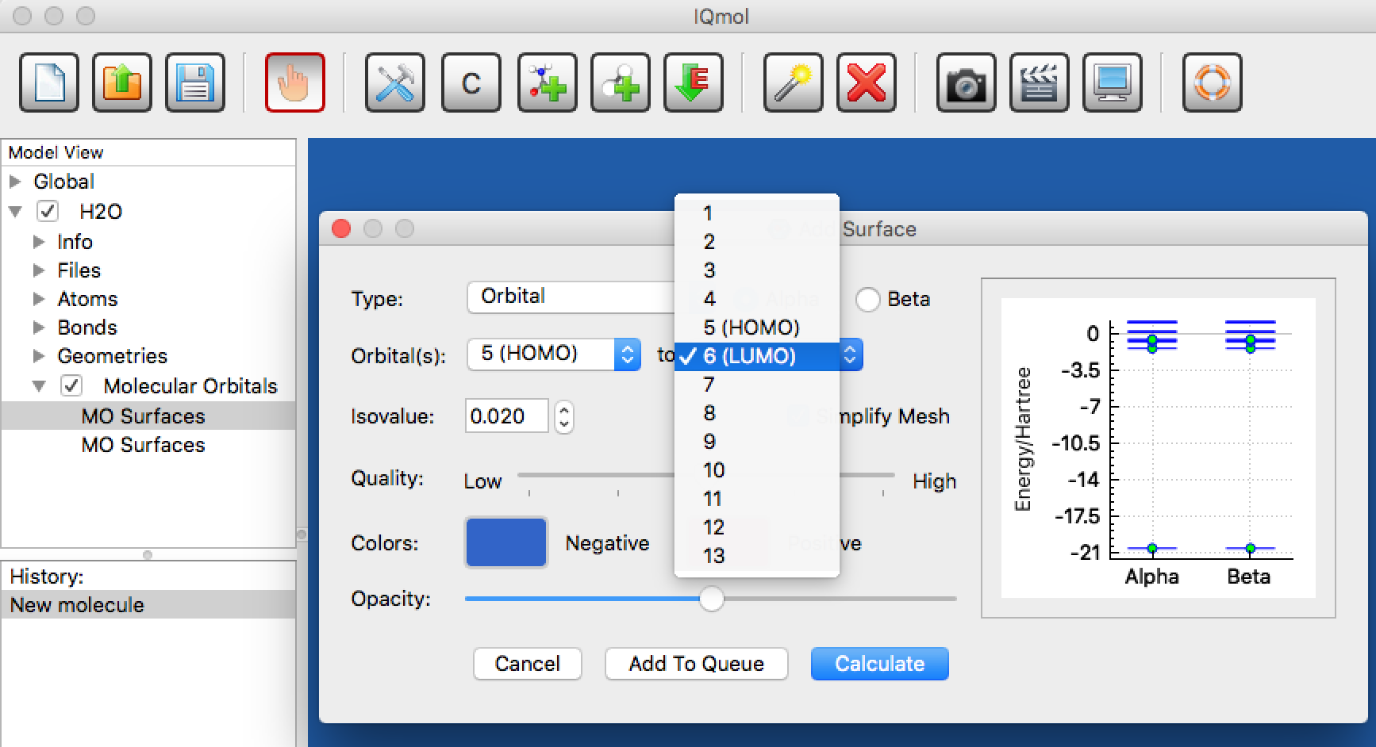
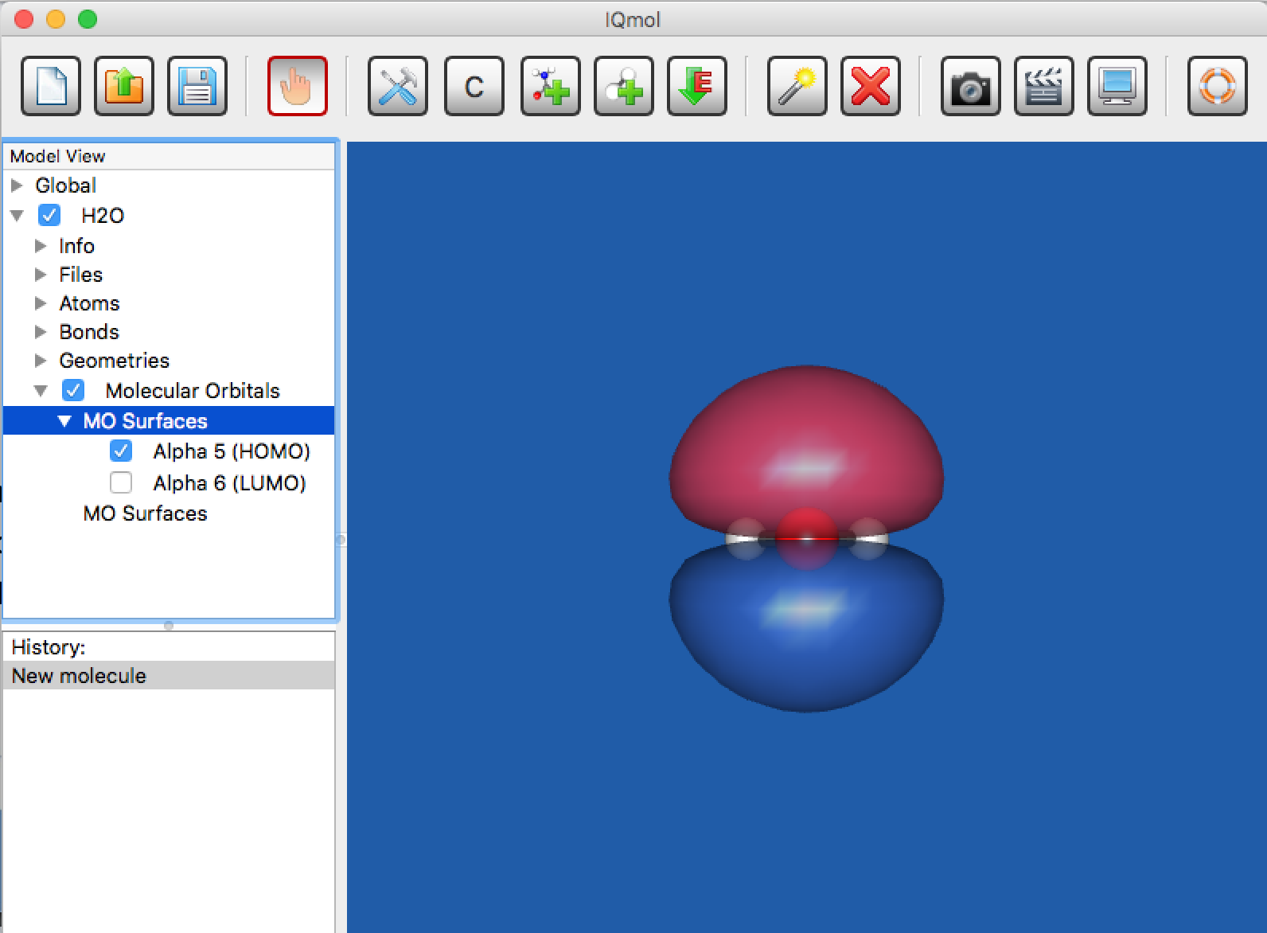
Analyzing Output: Orbitals, Density, Spin Density ,…
Select orbital
Select the relevant orbital (default: HOMO)
Select the quality you want
Click calculate
Click the arrow next to MO Surfaces to see the orbitals one by one by clicking the checkbox of the corresponding orbital (do not forget to uncheck the old one)
Use “Manipulate Mode" to better see the orbital
To save the screen: File —> Save Picture

Slide 41
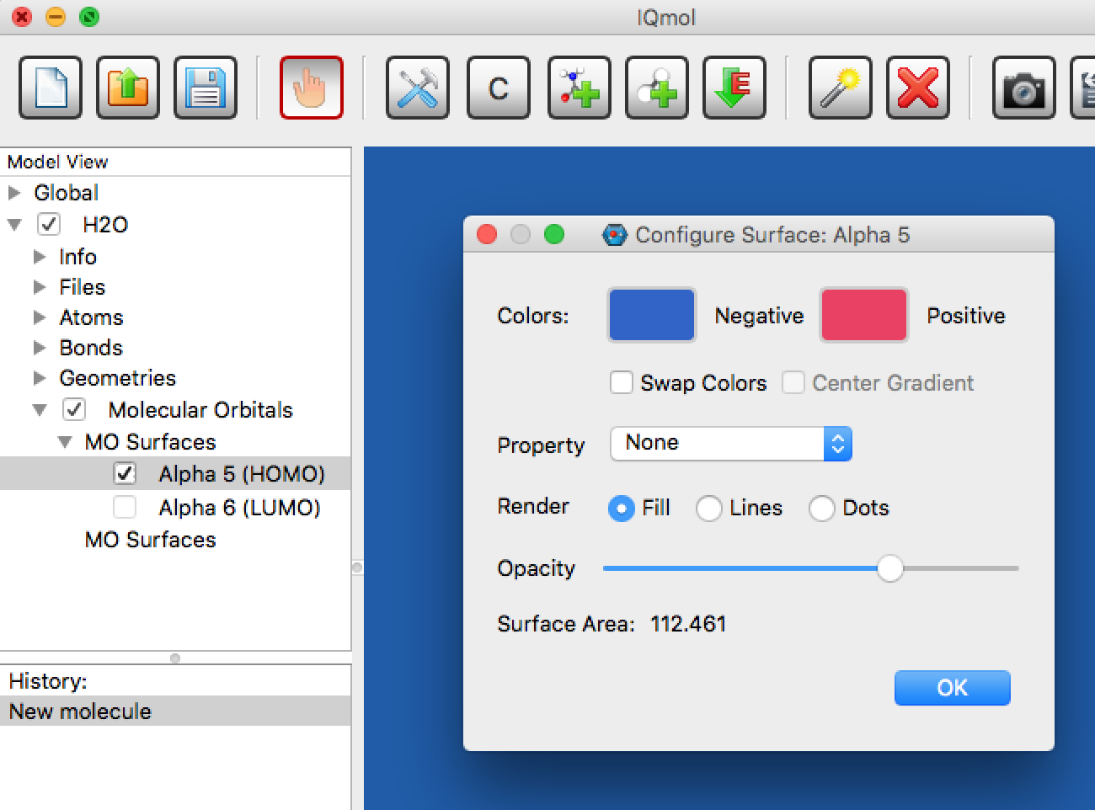
Analyzing Output: Orbitals, Density, Spin Density ,…
To change the quality of the surface double click on the orbital being displayed in MV.

Slide 42
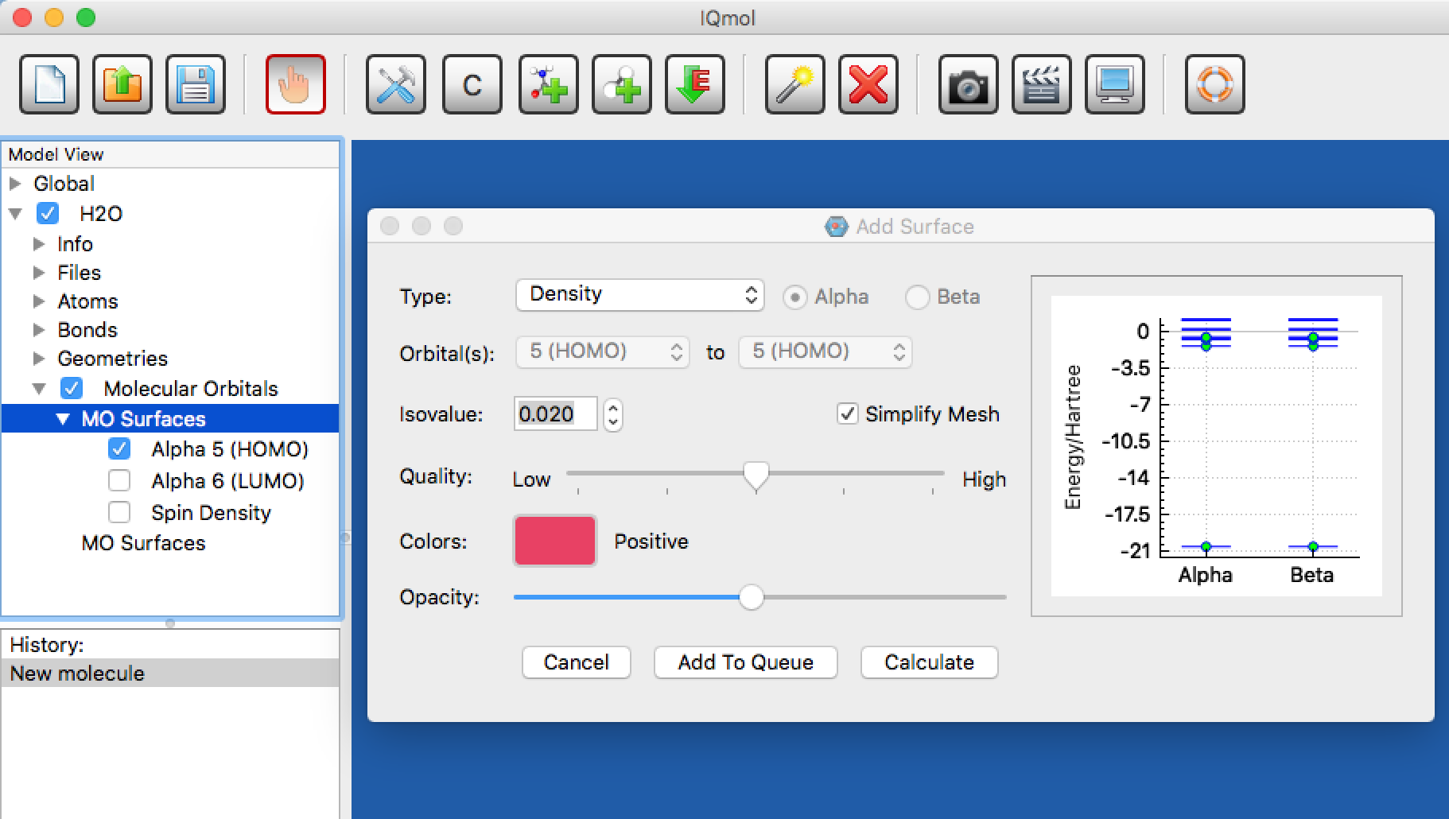
Analyzing Output: Orbitals, Density, Spin Density ,…
Double click on MO Surface again from MV panel
“Add Surface” window will pop up again
Select different properties to be calculated; spin density, density, and so on….

Slide 43
Performing Q-Chem calculations
Example 2: CH2O (Formaldehyde)

Slide 44
Formaldehyde
Build molecule, clean-up (force-field opt-n), check symmetry (symmetrize molecule)
Optimize wB97X-D/6-31+G*
Play with changing the view of the molecule, move it around, zoom
Use ‘Select’ feature to measure bonds and angles
Look at MOs: HOMO, HOMO-1, LUMO
Run FREQ job, look at vibrations (click versus double-click)
Advanced: Run NBO analysis, look at NBO charges and bond orders

Slide 45
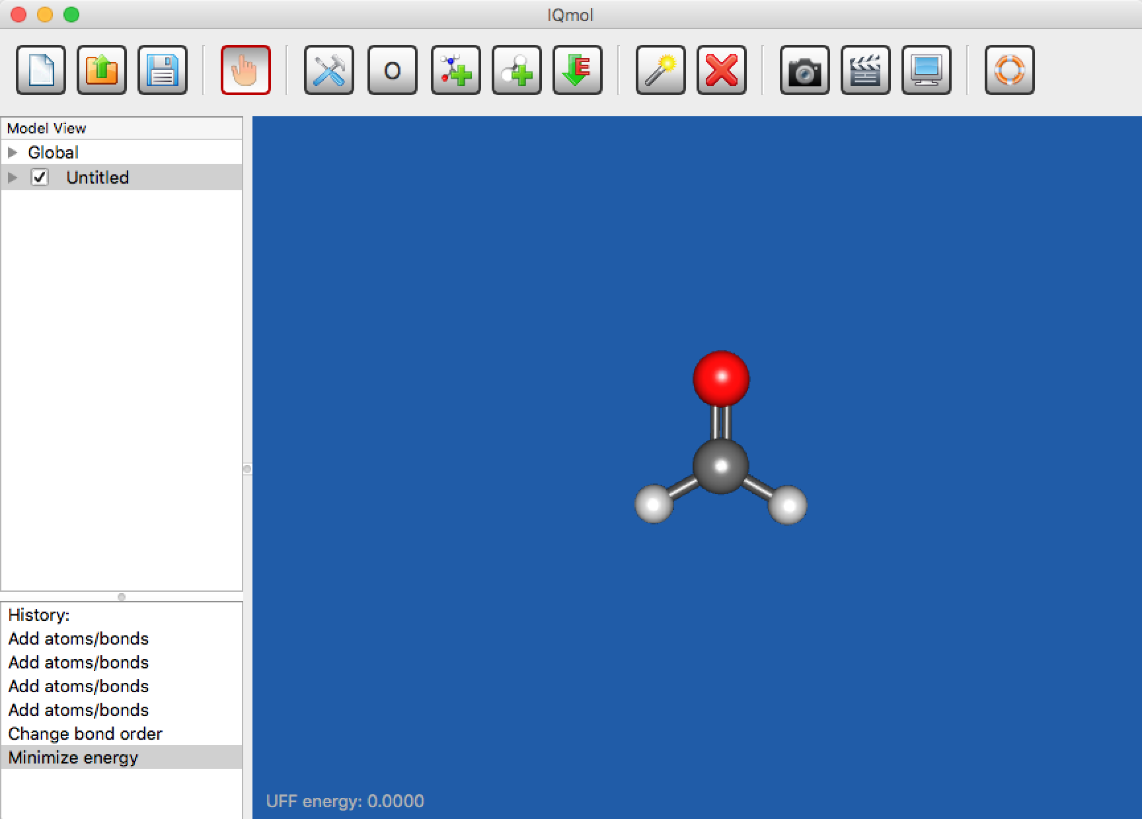
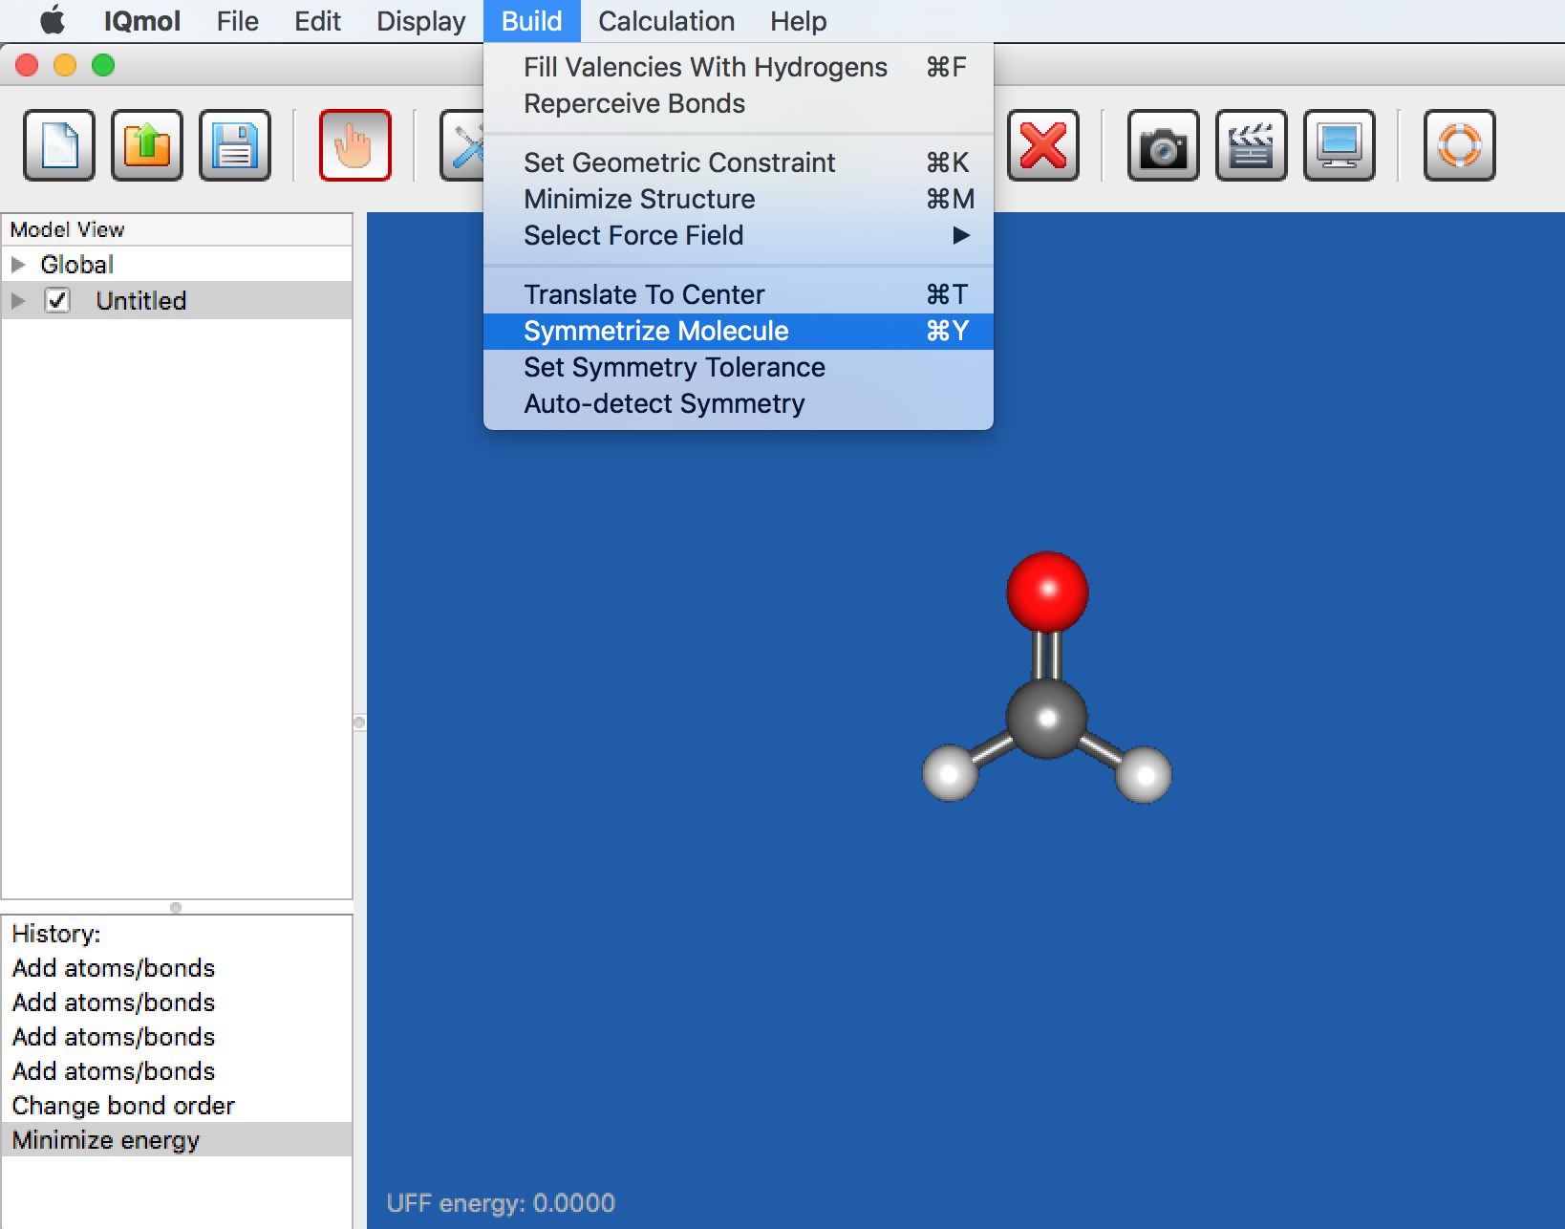
Building up/Check symmetry

Slide 46
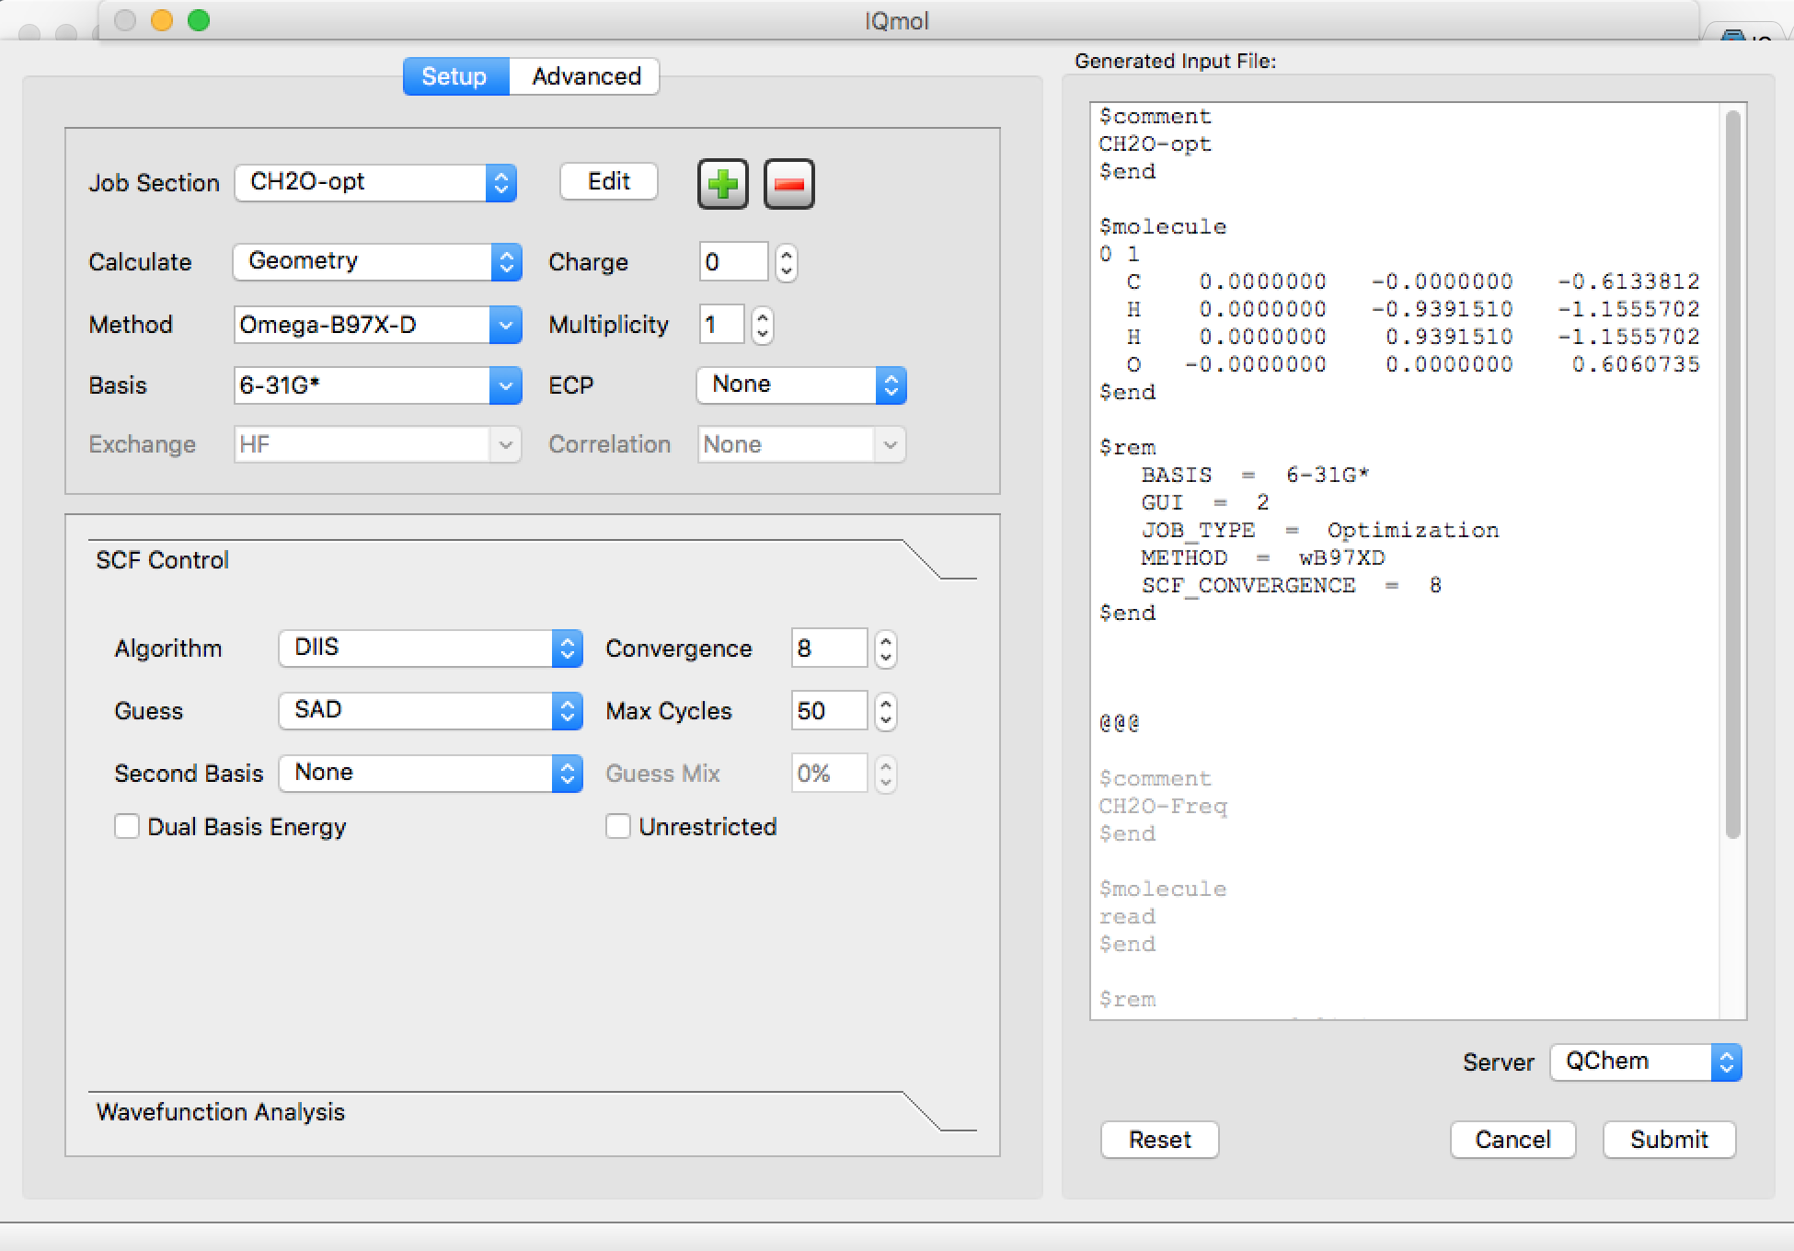
CH2O Optimization

Slide 47
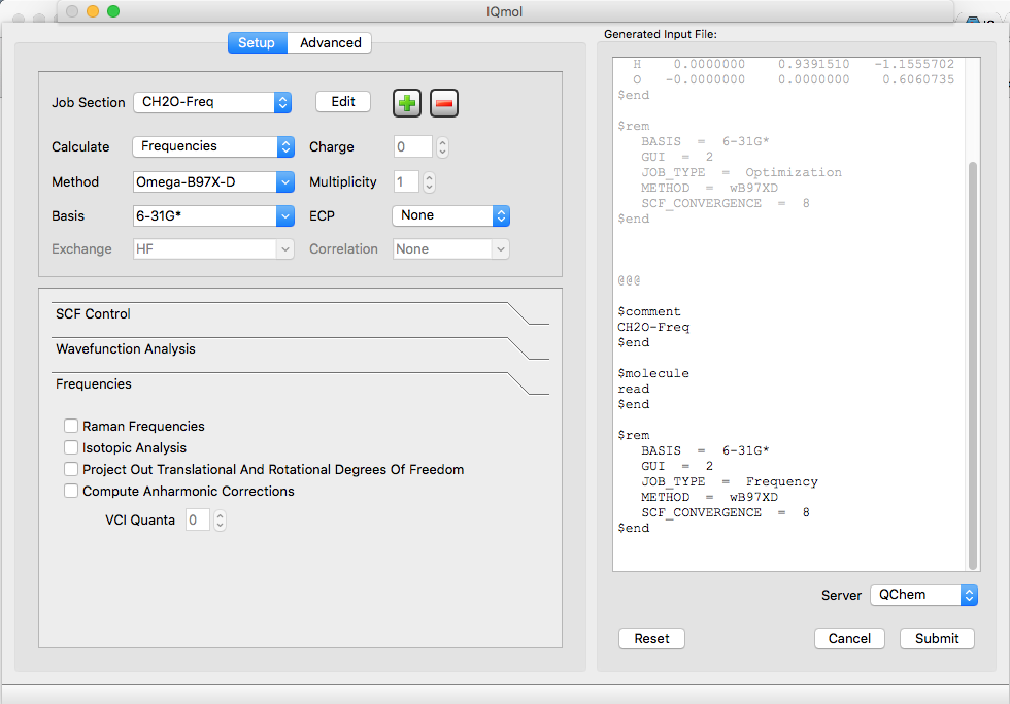
CH2O Frequency

Slide 48
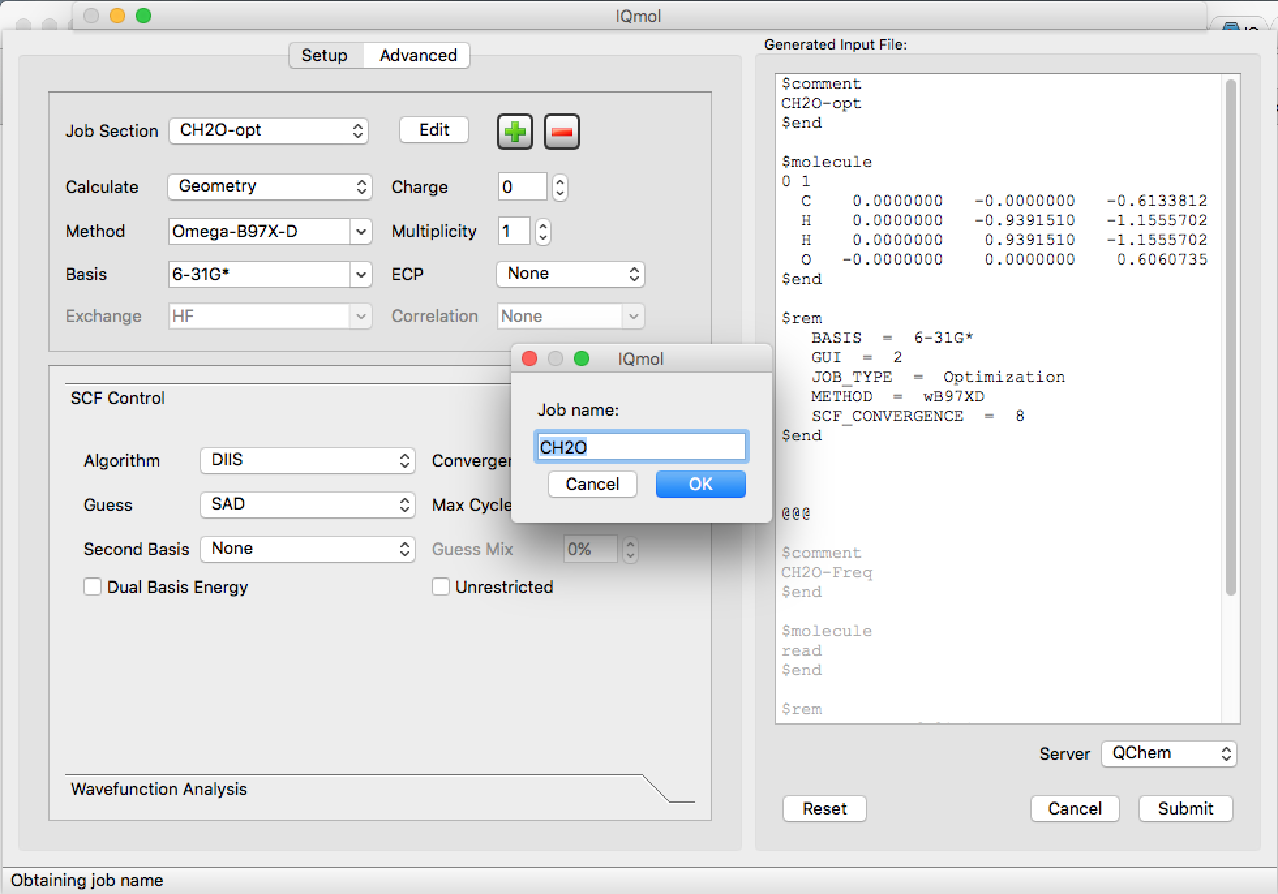
Submitting job to QChem

Slide 49
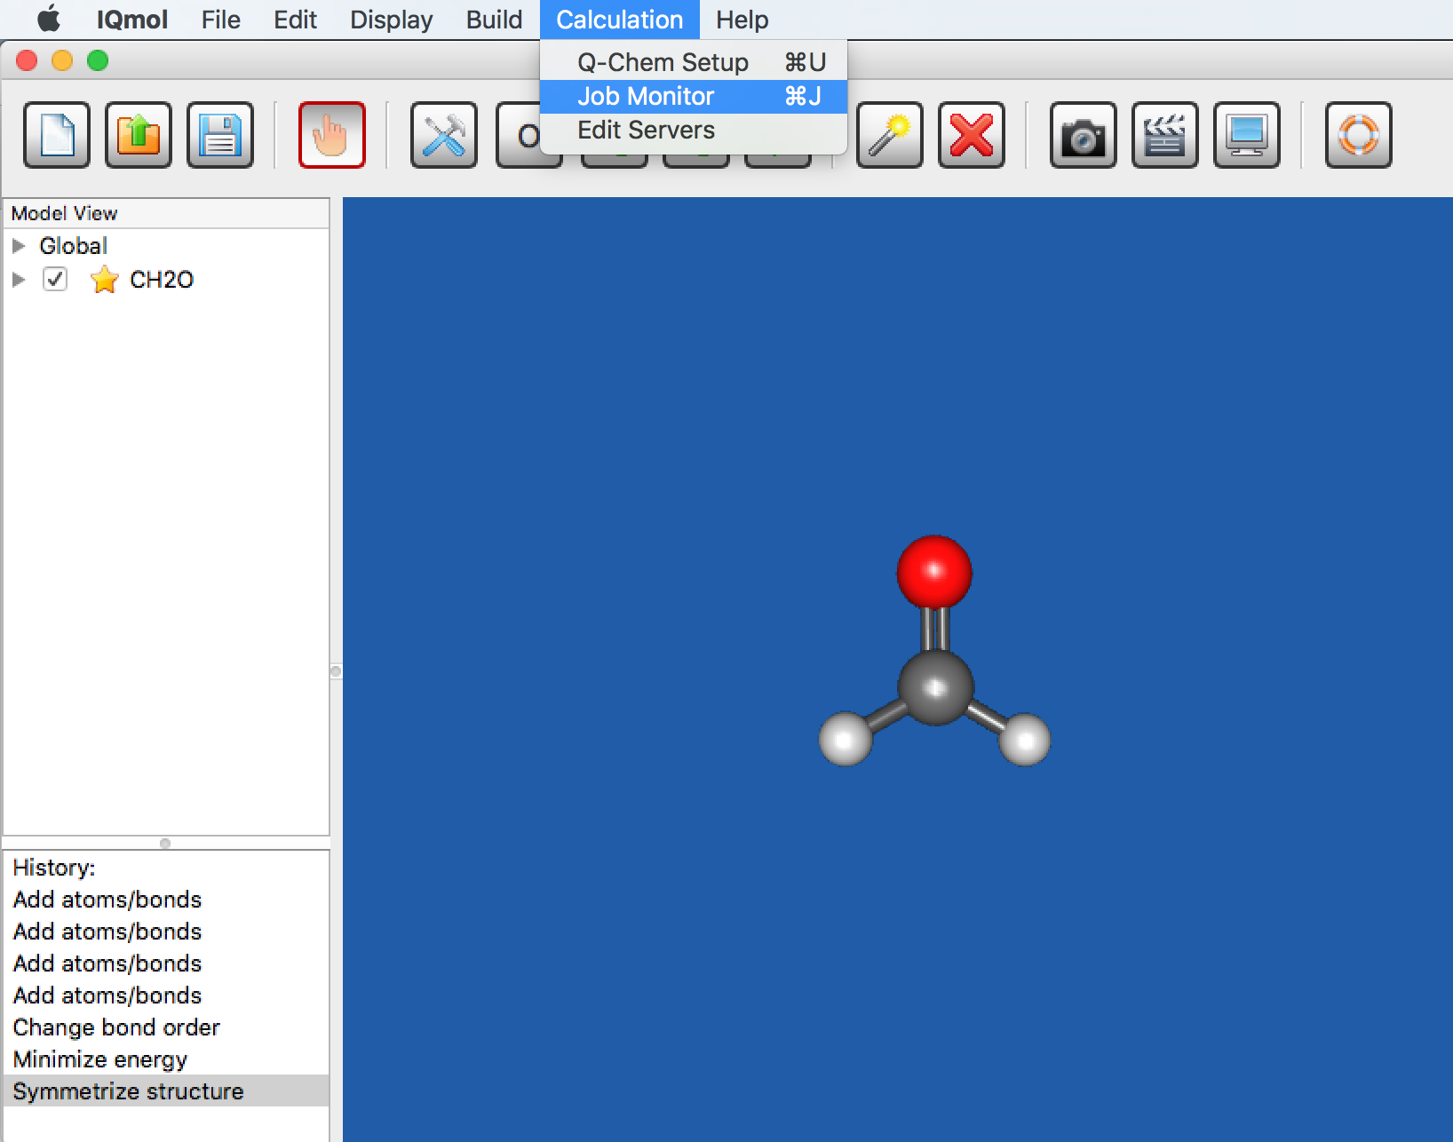
Monitoring submitted job

Slide 50
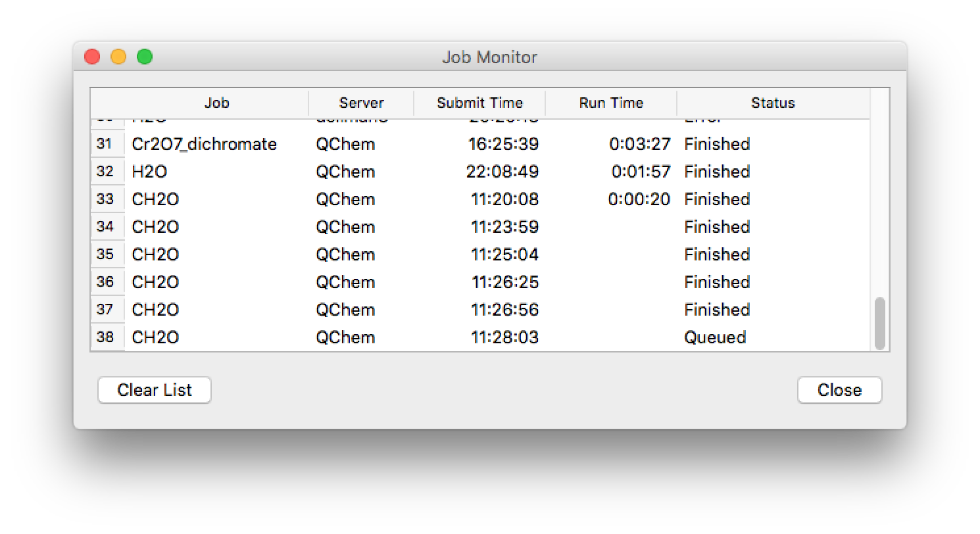
Monitoring submitted job

Slide 51
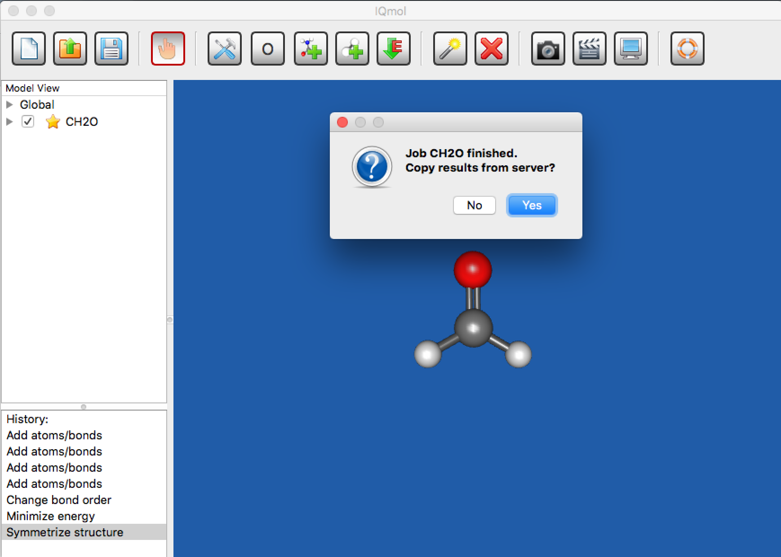
Job is finished

Slide 52
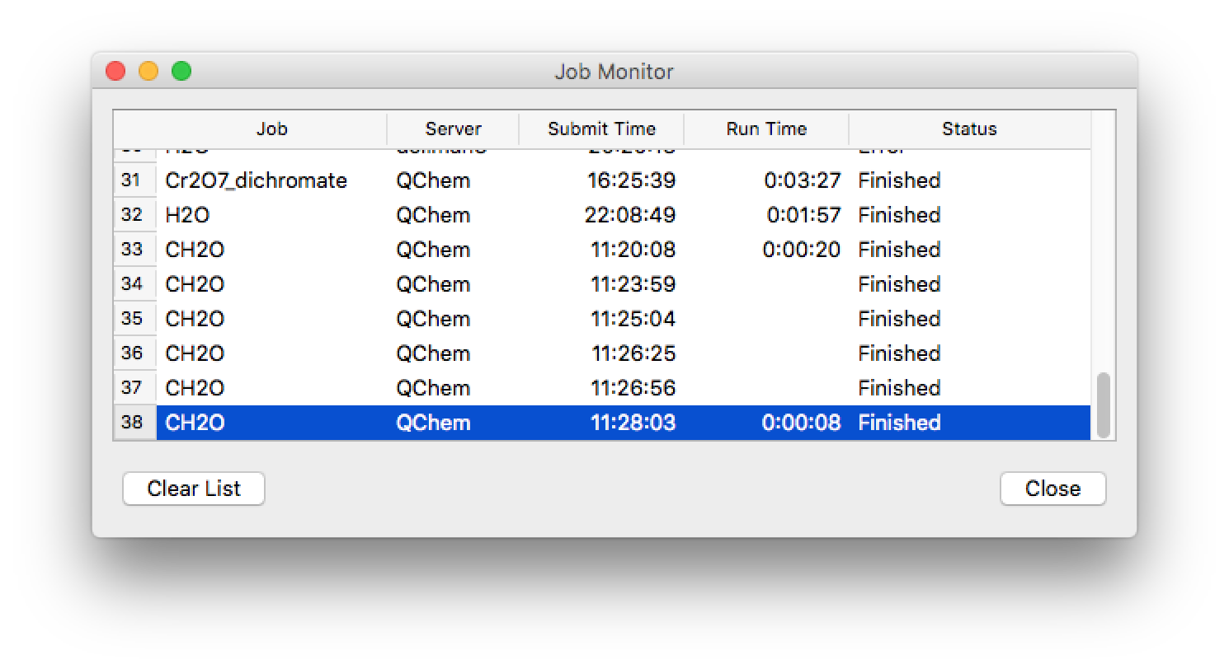
Copy files to your laptop

Slide 53
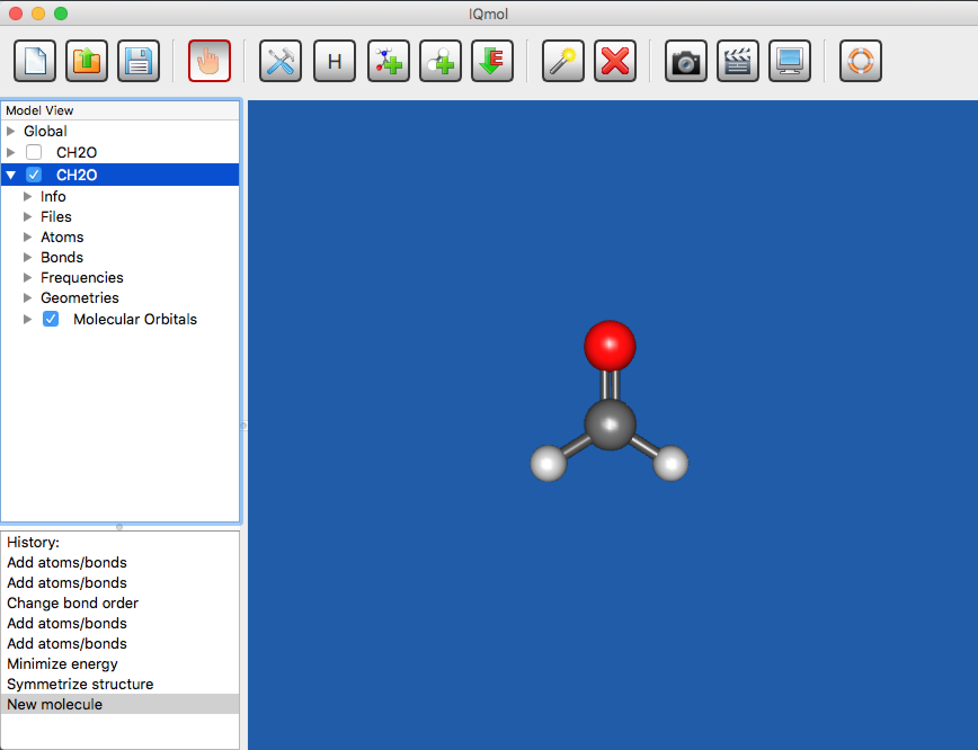
Analyze the output
click checkbox

Slide 54
Optimization cycles

Slide 55
Frequencies
3N-6= 6 vibrational frequency

Slide 56
Measuring parameters
Use “Select” mode to choose a bond, angle, torsion, …

Slide 57
HOMO-LOMO orbitals
Must add GUI = 2 in the $ rem section (IQmol does it by default)
Open .Fchk file to see Orbitals, Density, Spin density and so on.
Click at MO Surfaces and a window will pop up

Slide 58
HOMO-LOMO orbitals
Select Orbital
Select the relevant orbital (default: HOMO)
Select the quality you want
Click calculate
Click the arrow next to Surfaces to see the orbitals one by one by clicking the checkbox of the corresponding orbital (do not forget to uncheck the old one)
Use Manipulation Mode to better see the orbital
To save the screen: File —> Save Picture

