Slide 1
IQmol:
Troubleshooting
Fazle Rob, Shirin Faraji, Ilya Kaliman, and Anna Krylov

Slide 2
Resources
Written by Dr. Andrew Gilbert
Keep yourself up to date with IQmol website: http://iqmol.org
IQmol Youtube channel: IQmol now has its own Youtube channel

Slide 3
IQmol: Troubleshooting
Known problems and glitches:
When configuring servers, follow the instructions precisely. If you get crashes when configuring the server, delete the configuration and start over again.
2. If IQmol stops working (warnings like “cannot create a directory”) restart IQmol and try again. Sometimes this problem arises because of a permission problem. In which case this is not a IQmol problem. Otherwise, a bug reporting would be much appreciated.
3. If connection is poor, IQmol may show the running job as failed. In this case (or crashed IQmol job, or prolonged job) you can copy the output and checkpoint files manually (by sftp) to your laptop and then open them by IQmol (may need to rename checkpoint files). This can also be accomplished by double clicking the job in the Job Monitor window.
4. If jobs fails at Q-Chem with error in the output file IQmol can still download it from the remote Q-Chem server but will not show in the Model View panel. In this case the output or summary of the error can be viewed by selecting the job in the Job Monitor followed by mouse right-click for a menu and clicking View Output File. IQmol will display the output file in a File View window.

Slide 4
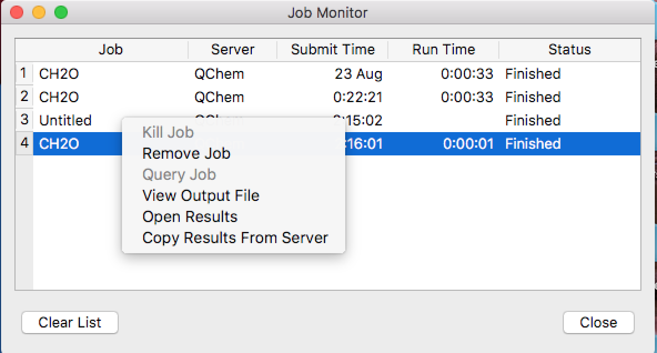
IQmol: Troubleshooting

Slide 5
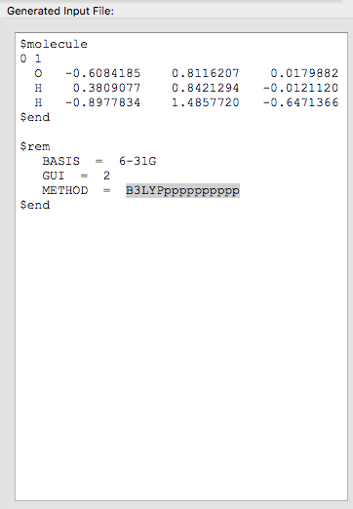
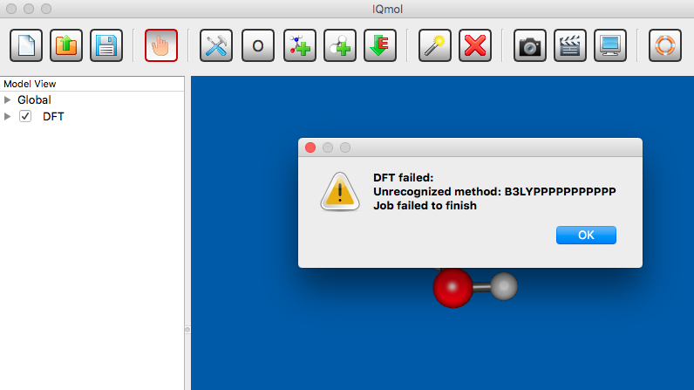
IQmol: Troubleshooting
Unavailable (or invalid) methods or keywords in the input file – e.g. if an invalid exchange functional is given as method keyword the following error message will be generated.

Slide 6
Recent issues
1. With recent ssh, IQmol server setup needs to be modified such that ~/user is not used when specifying working directory on the server. Spell it explicitly.
2. Sometimes it helps to close and open IQmol again. Somehow it gets confused by previous failed settings.

